Slide 1
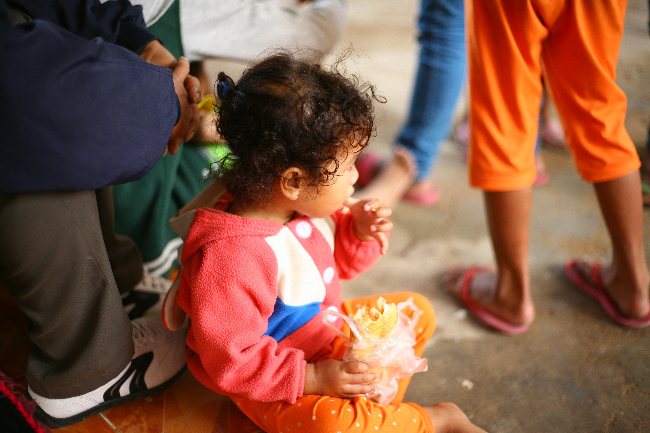
Every month, USAID–funded Counter Trafficking In Persons CTIP program’s partner Cambodian Center for the Protection of Children’s Rights (CCPCR) cooperates with the Vietnamese immigration police and shelter to rescue and repatriate Cambodians caught begging in Vietnam. The majority of them are children who come from the bordering province of Svay Rieng, where numerous desperate families regularly bring their children to beg in Vietnam.

Slide 2
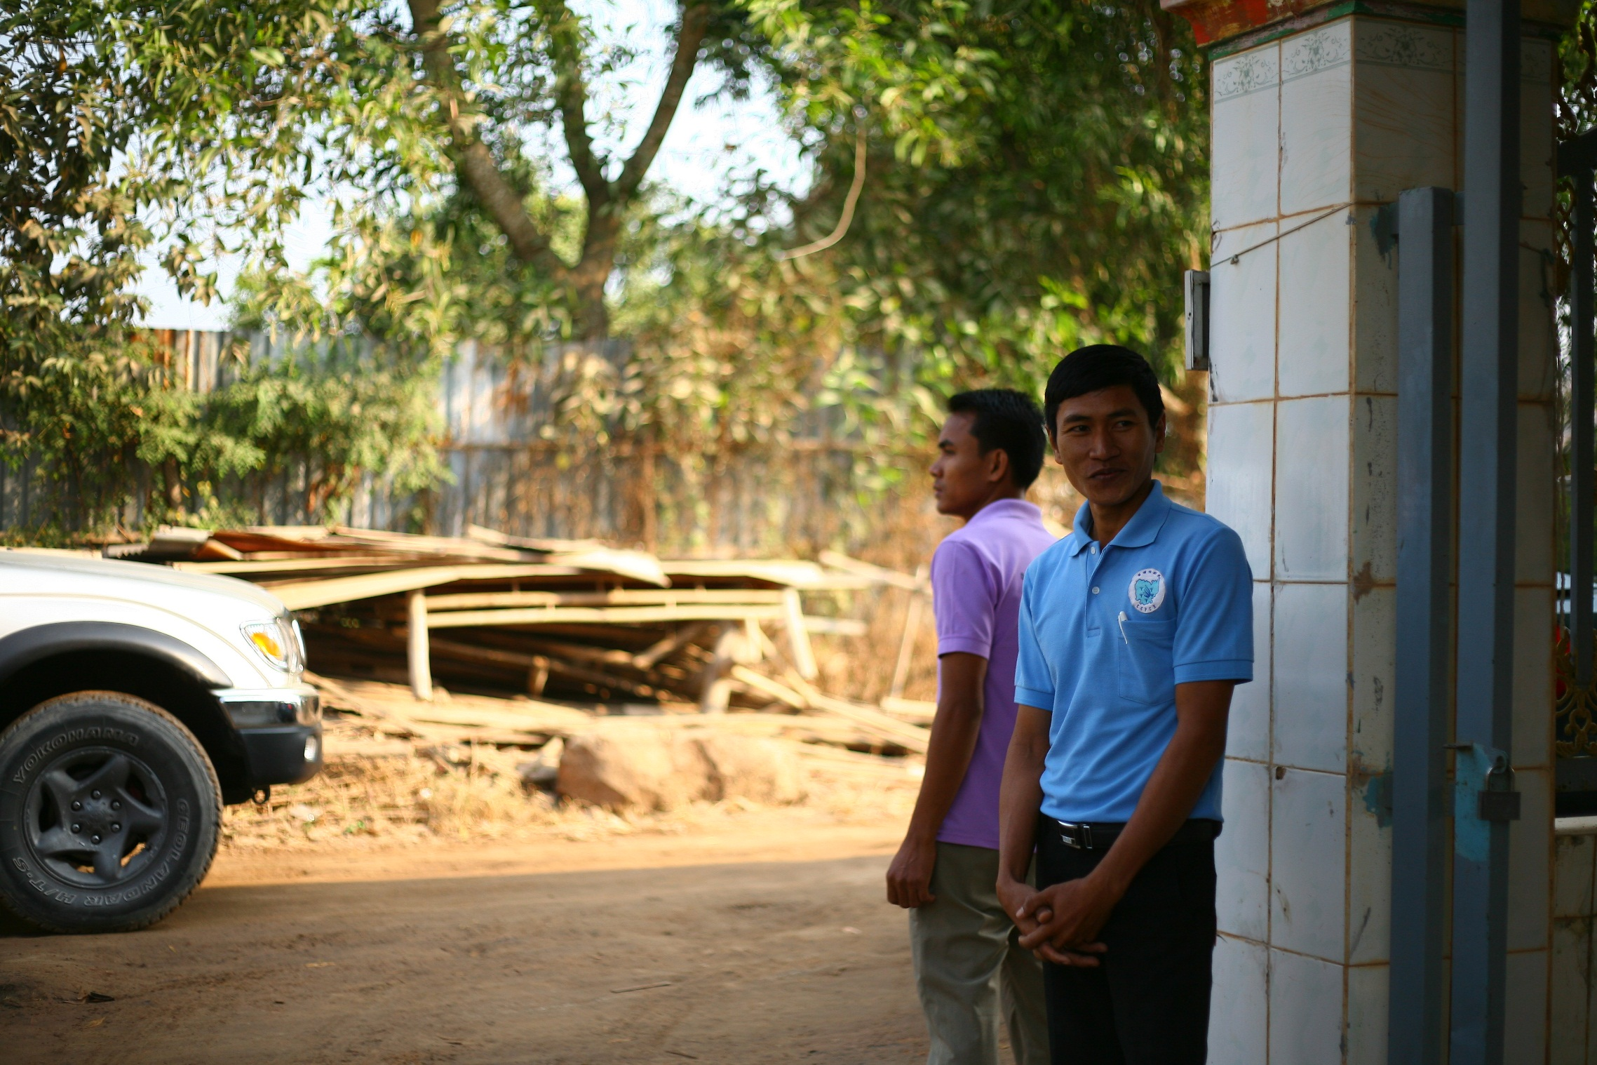
On repatriation days, the restless staff of CTIP’s partner CCPCR waits for the arrival of returnees. The representatives of the Ministry of Social Affairs (MoSAVY) and other local NGOs are also present at CCPCR’s transit center to welcome them.

Slide 3
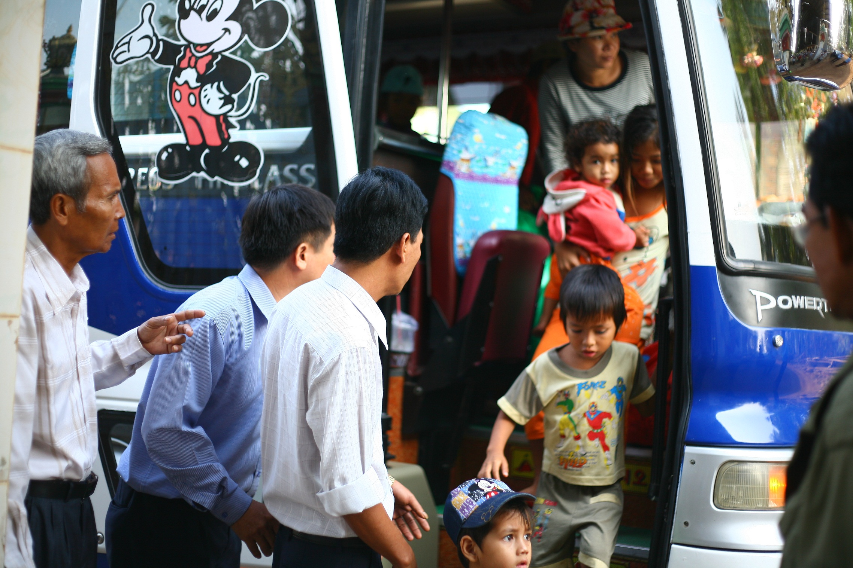
All returnees finally reach the end of their journey from Vietnam and get out of the bus. After having been arrested and detained, they tread once again the native soil of Cambodia. Out of the returnees this time, 32 of them are children and around half of them are girls.

Slide 4
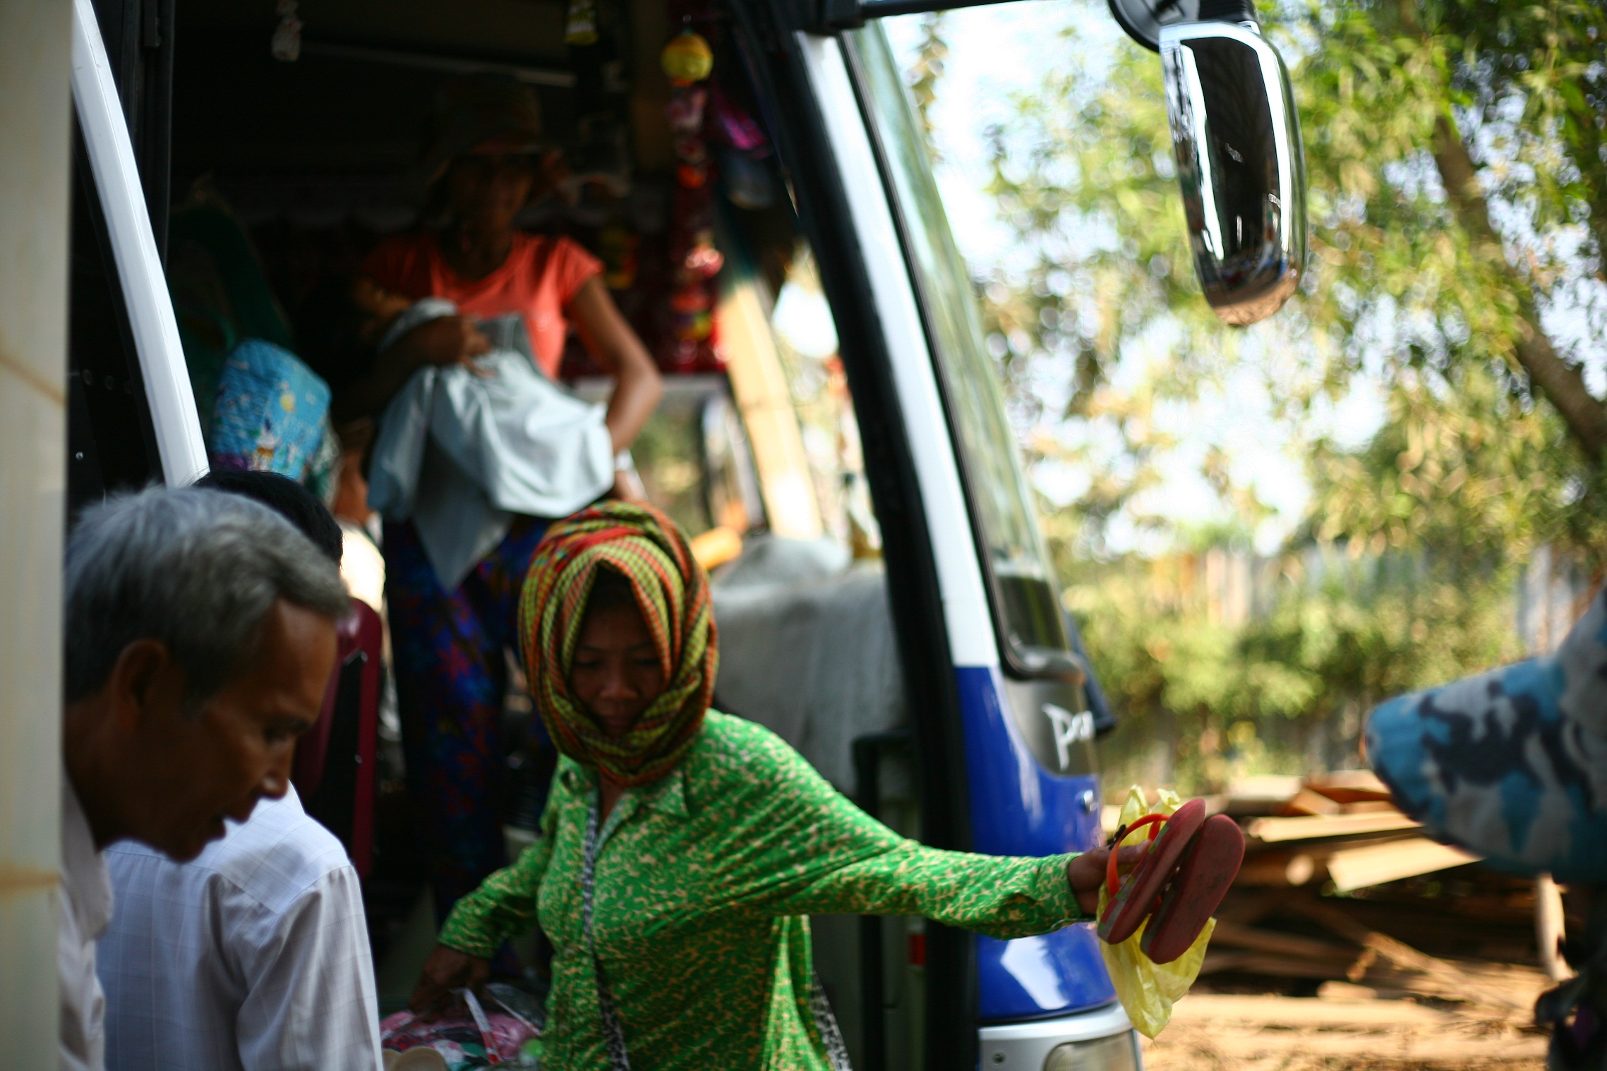
Some of them feel dismayed. Back to square one.

Slide 5
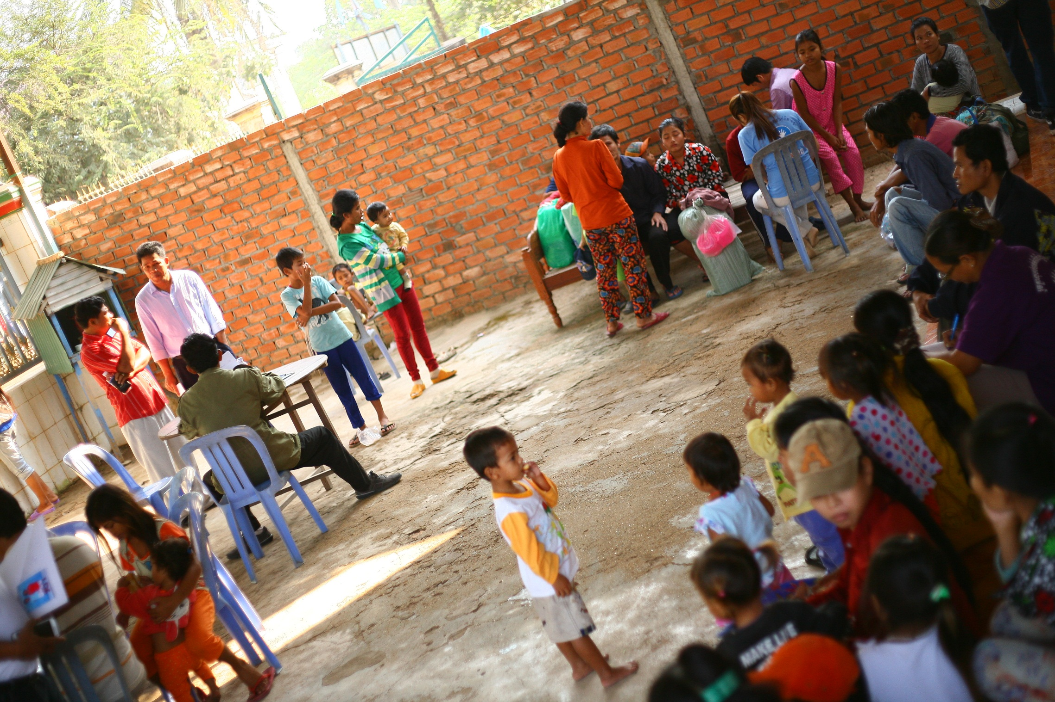
Now starts another long wait. CTIP program and all present key stakeholders will quickly screen each of them to identify if they are victims of human trafficking.

Slide 6
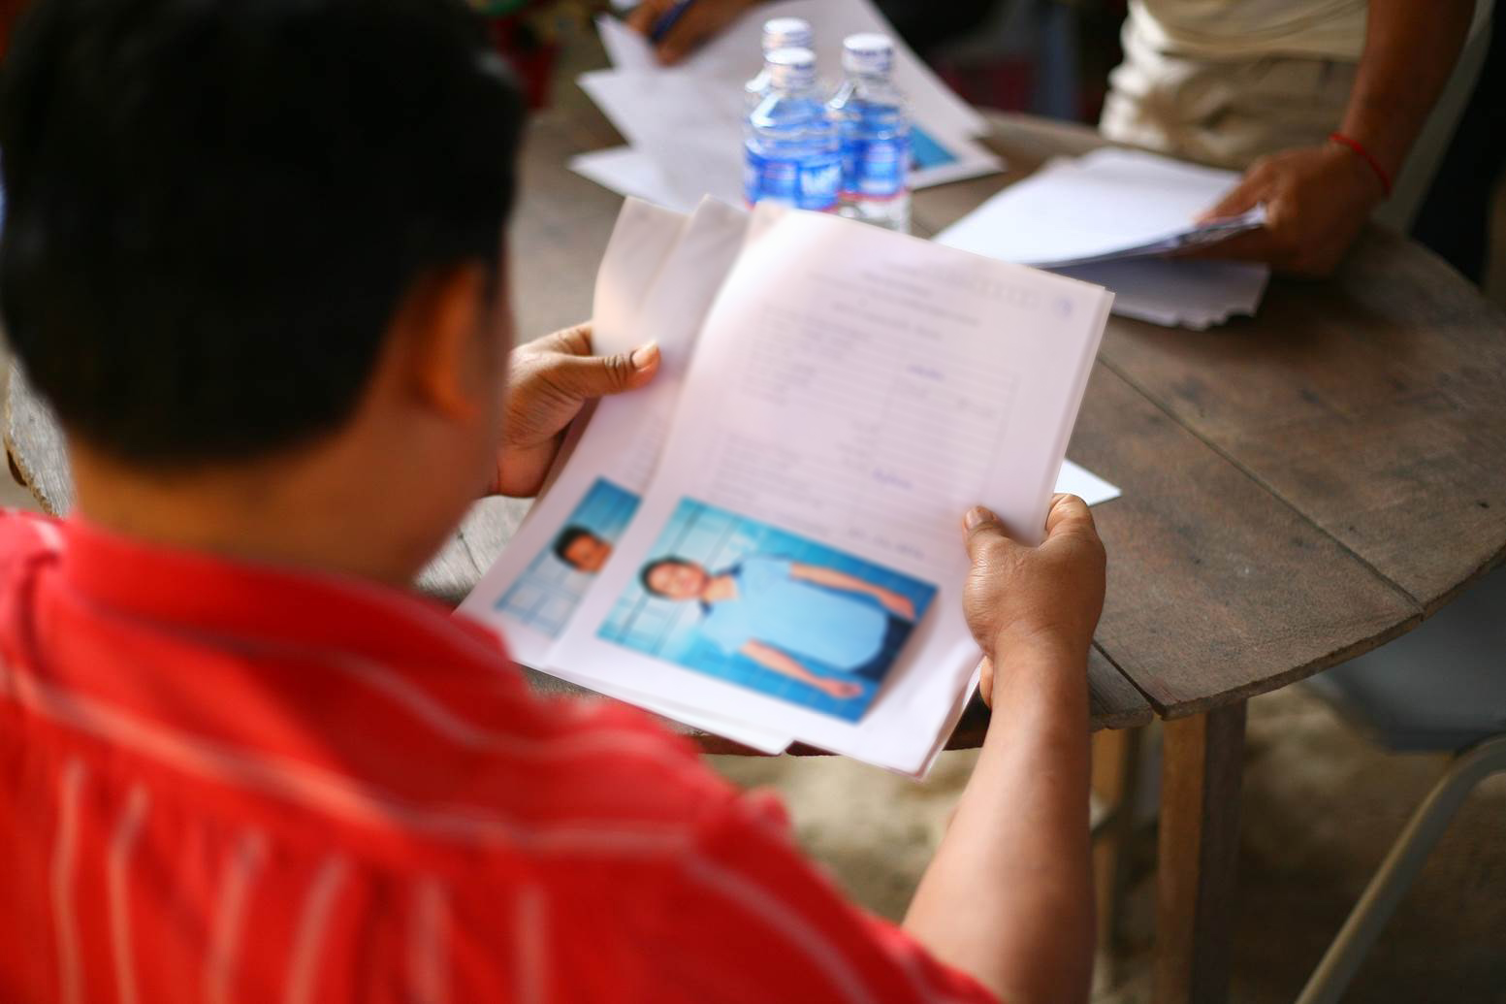
In Vietnam, the shelter’s staff took a photo of each returnee and collected information about them.

Slide 7
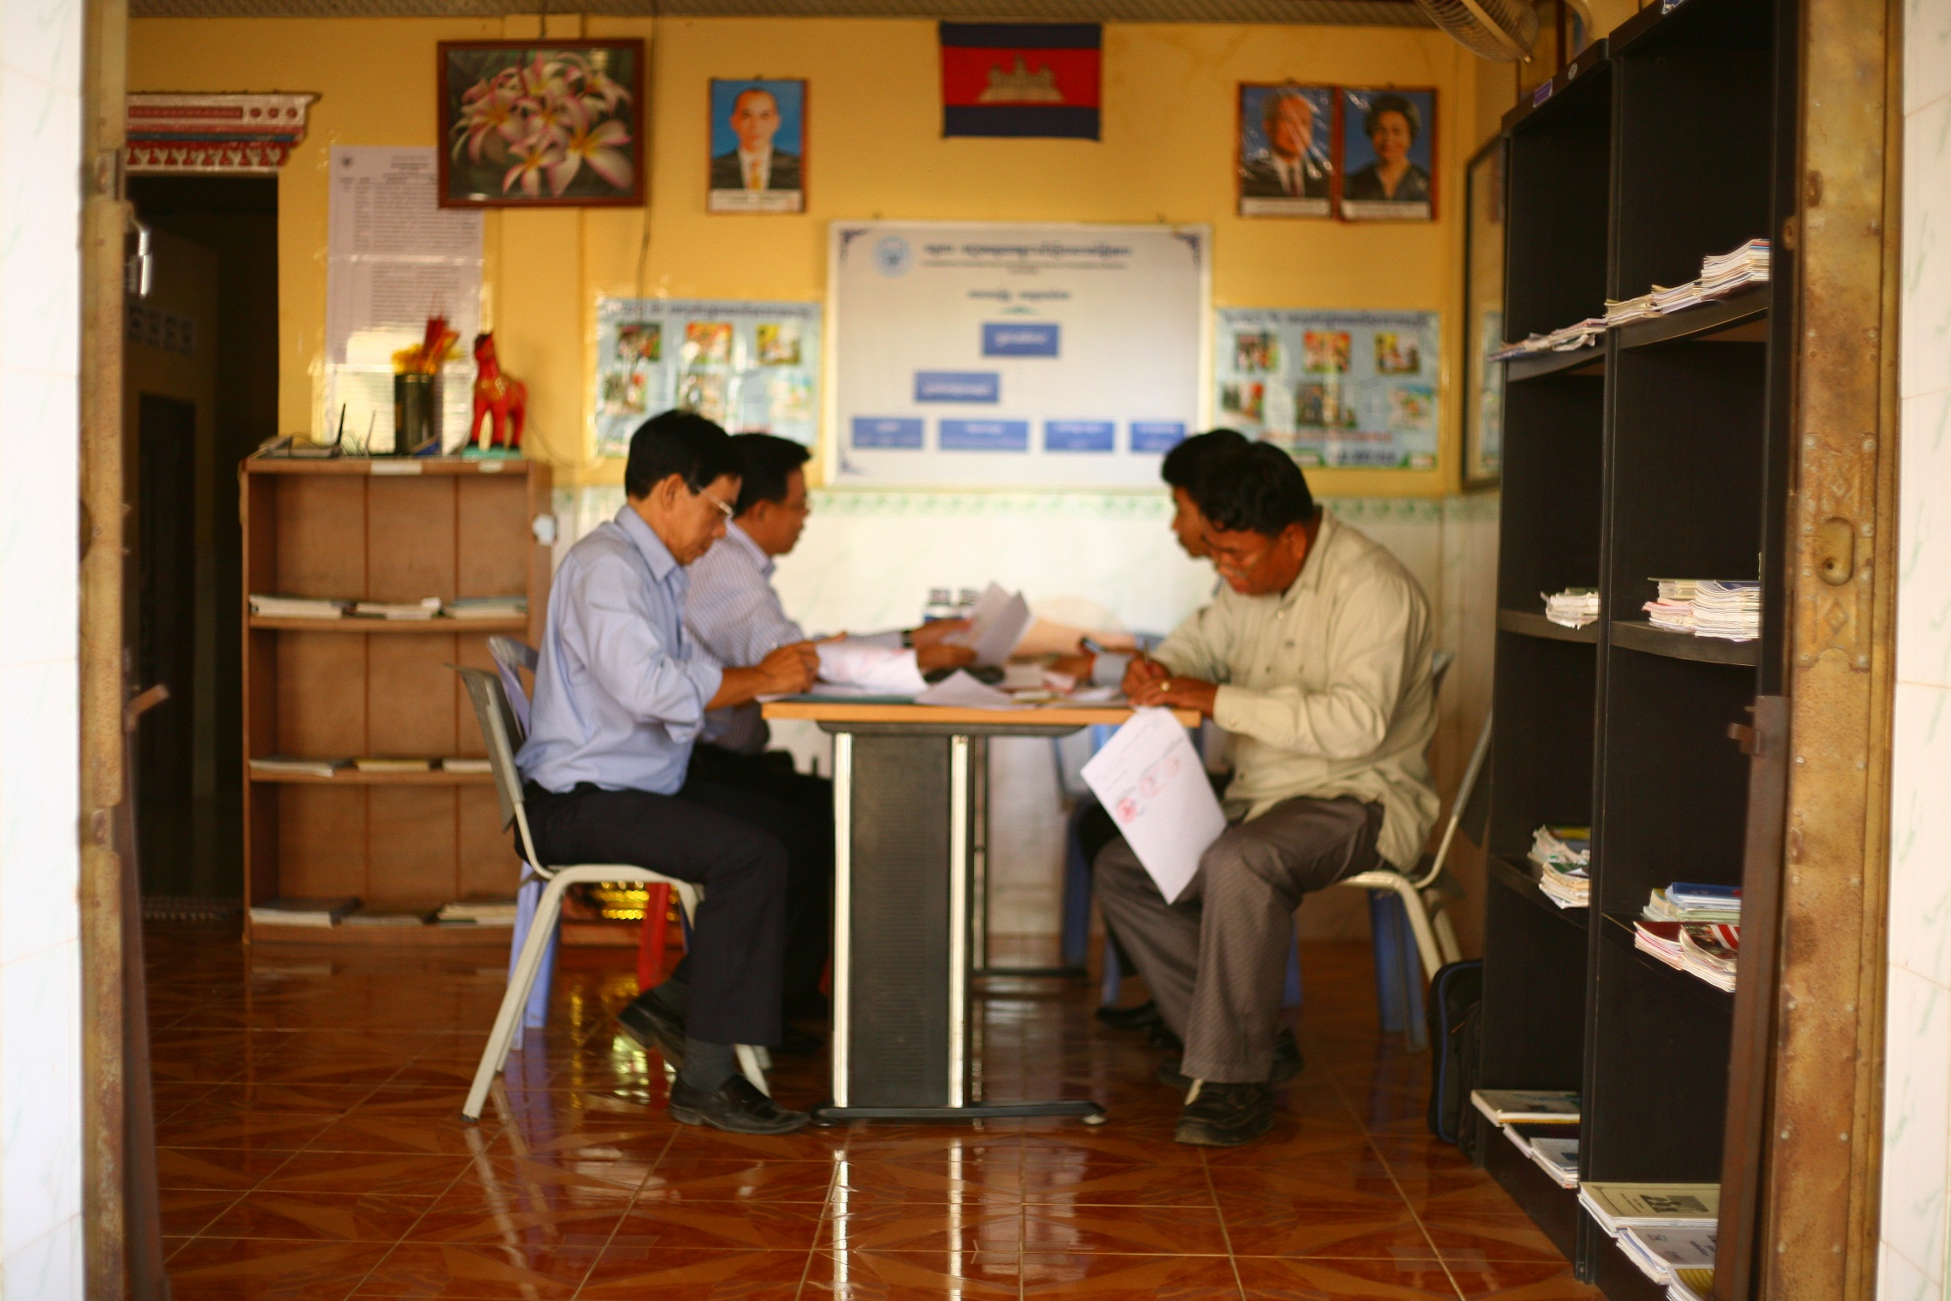
The representatives of MoSAVY and of the Vietnamese shelter share lists of returnees and all collected information.

Slide 8
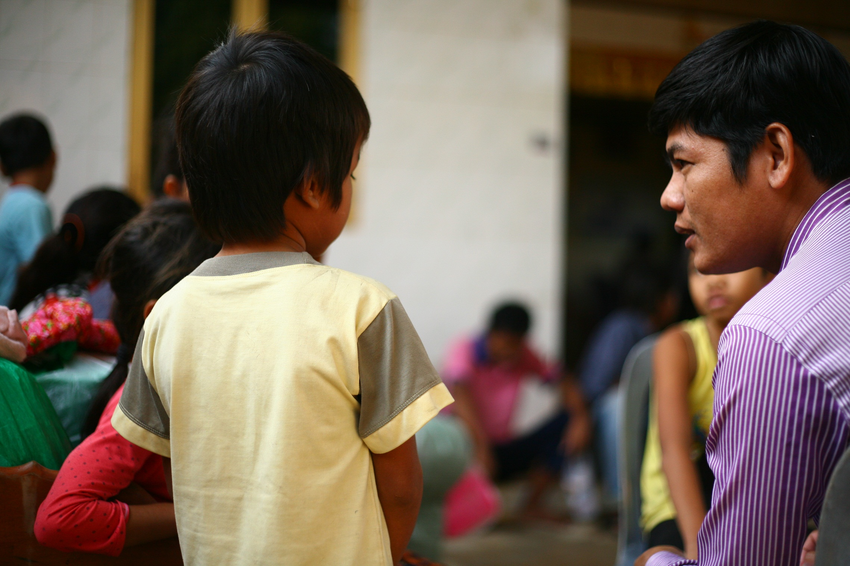
CTIP‘s partner CCPCR’s social workers briefly interview returnees. “Where did you stay in Vietnam? With whom? What did you do there? Why did you decide to migrate?” are typical questions asked. Other local NGOs help in the effort.

Slide 9
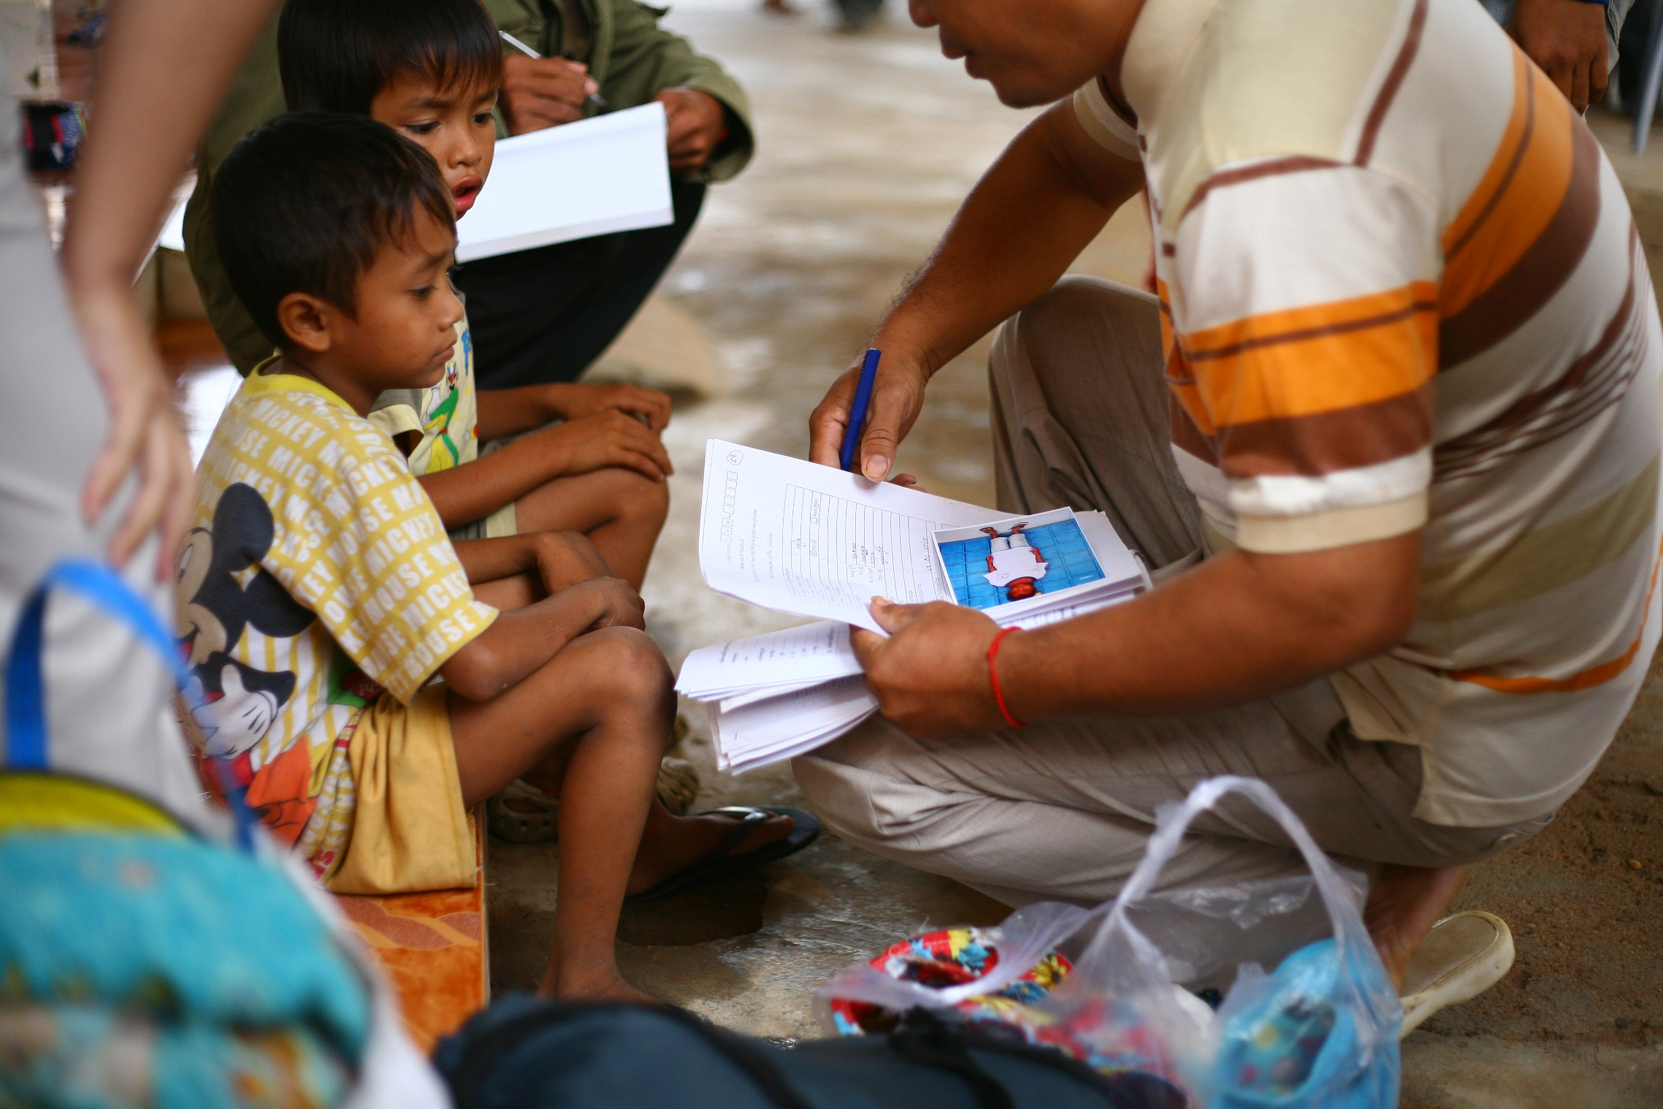
The majority of returnees are children, brought along with their families, especially during the Vietnamese New year which is considered as good times for collecting money. “Young children easily move people’s pity”.

Slide 10
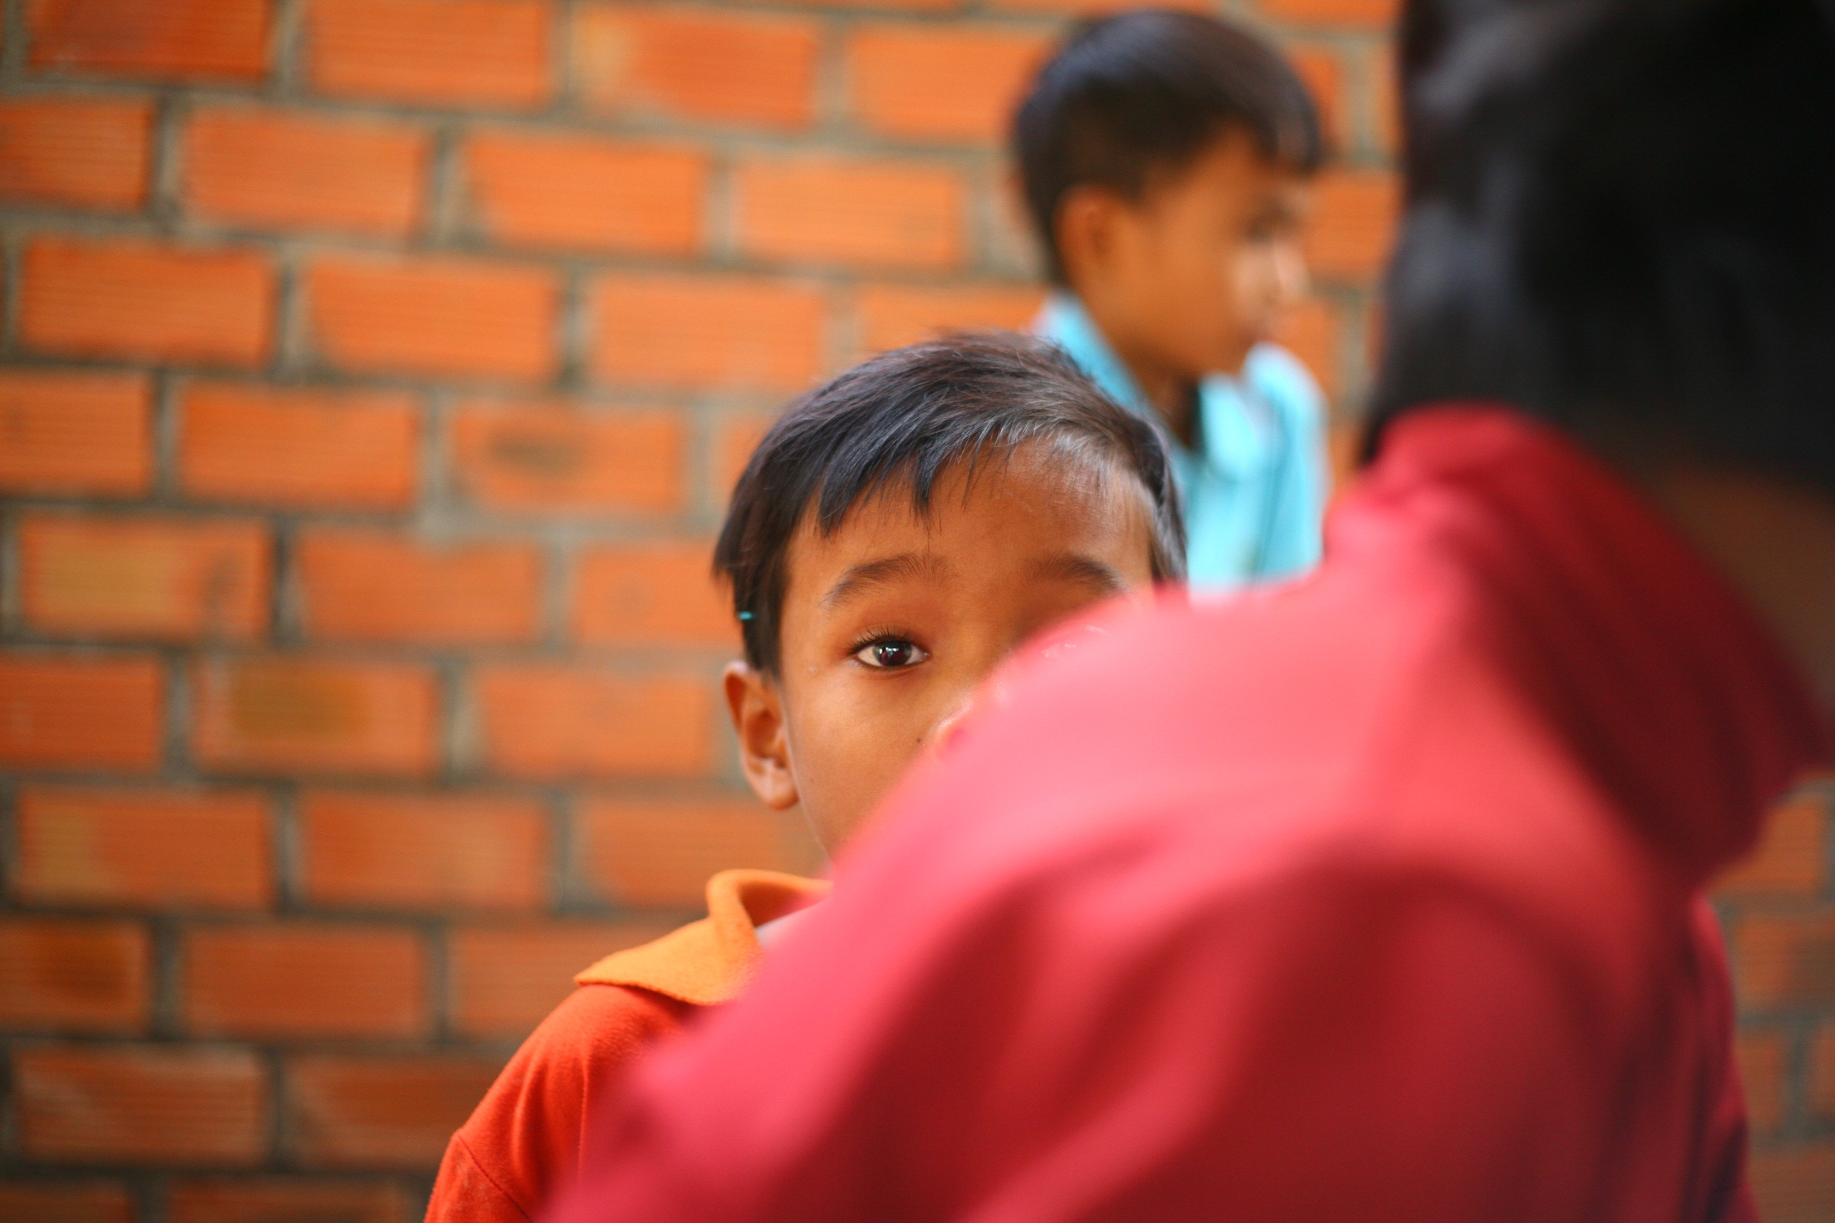
“My parents and me went to Vietnam because we didn’t have enough food to eat here”, usually explain children.

Slide 11
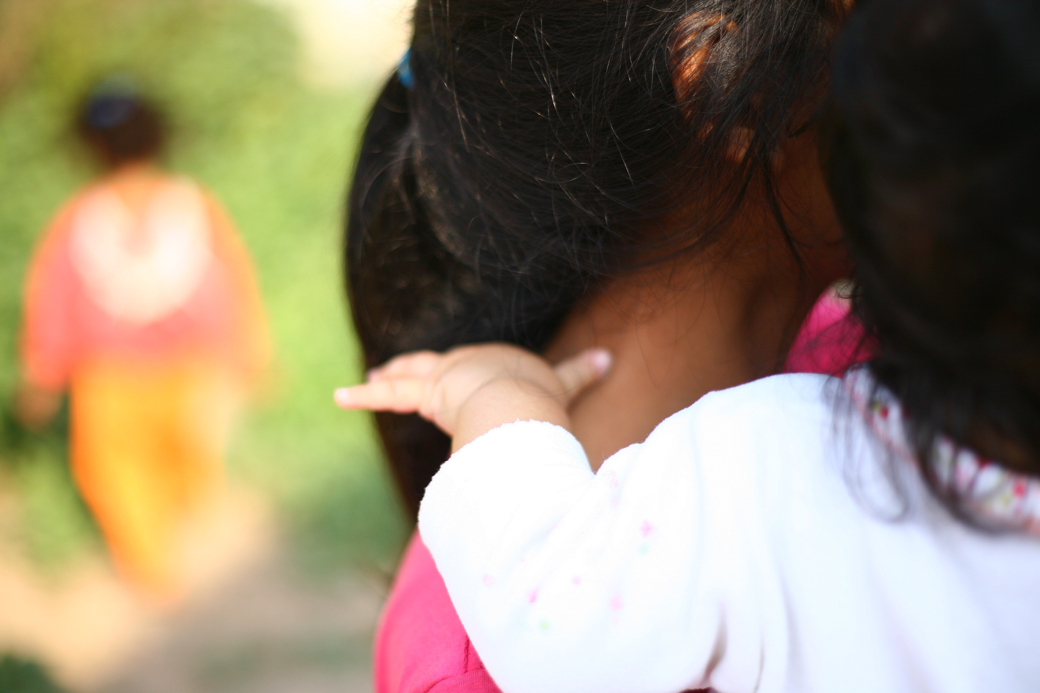
“Most of them are not mad with their parents even if they didn’t want to accompany them. They are just happy to be back and meet their friends, family and community again. Depending on their age, they don’t understand what happened or feel that they had no choice but to follow their parents. Some families even beat or do not feed their children if they come home empty-handed”, says Somnang, social worker of CTIP’s partner CCPCR.

Slide 12
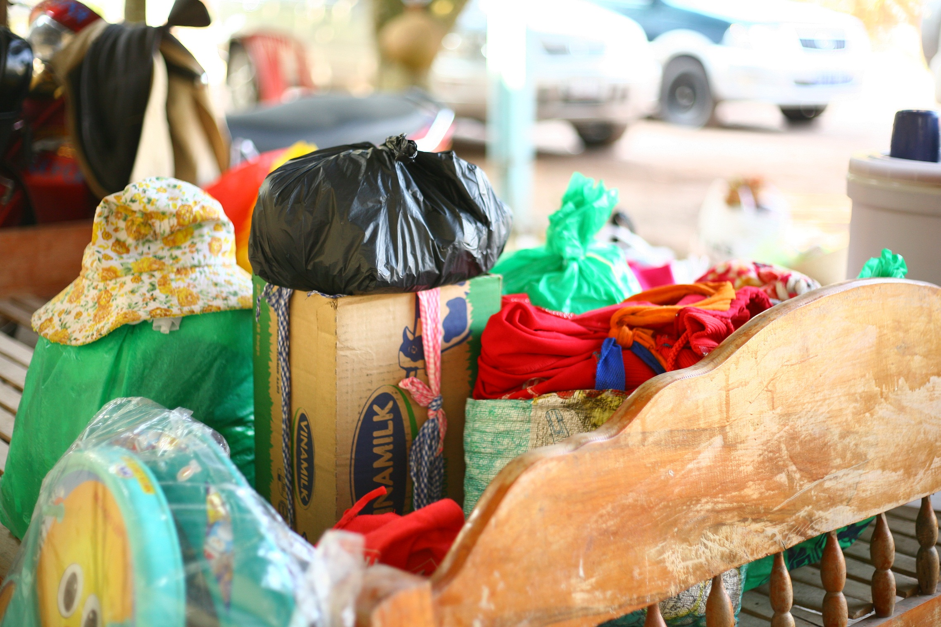
Everywhere in the transit center can be seen bits of the returnees’ lives.

Slide 13
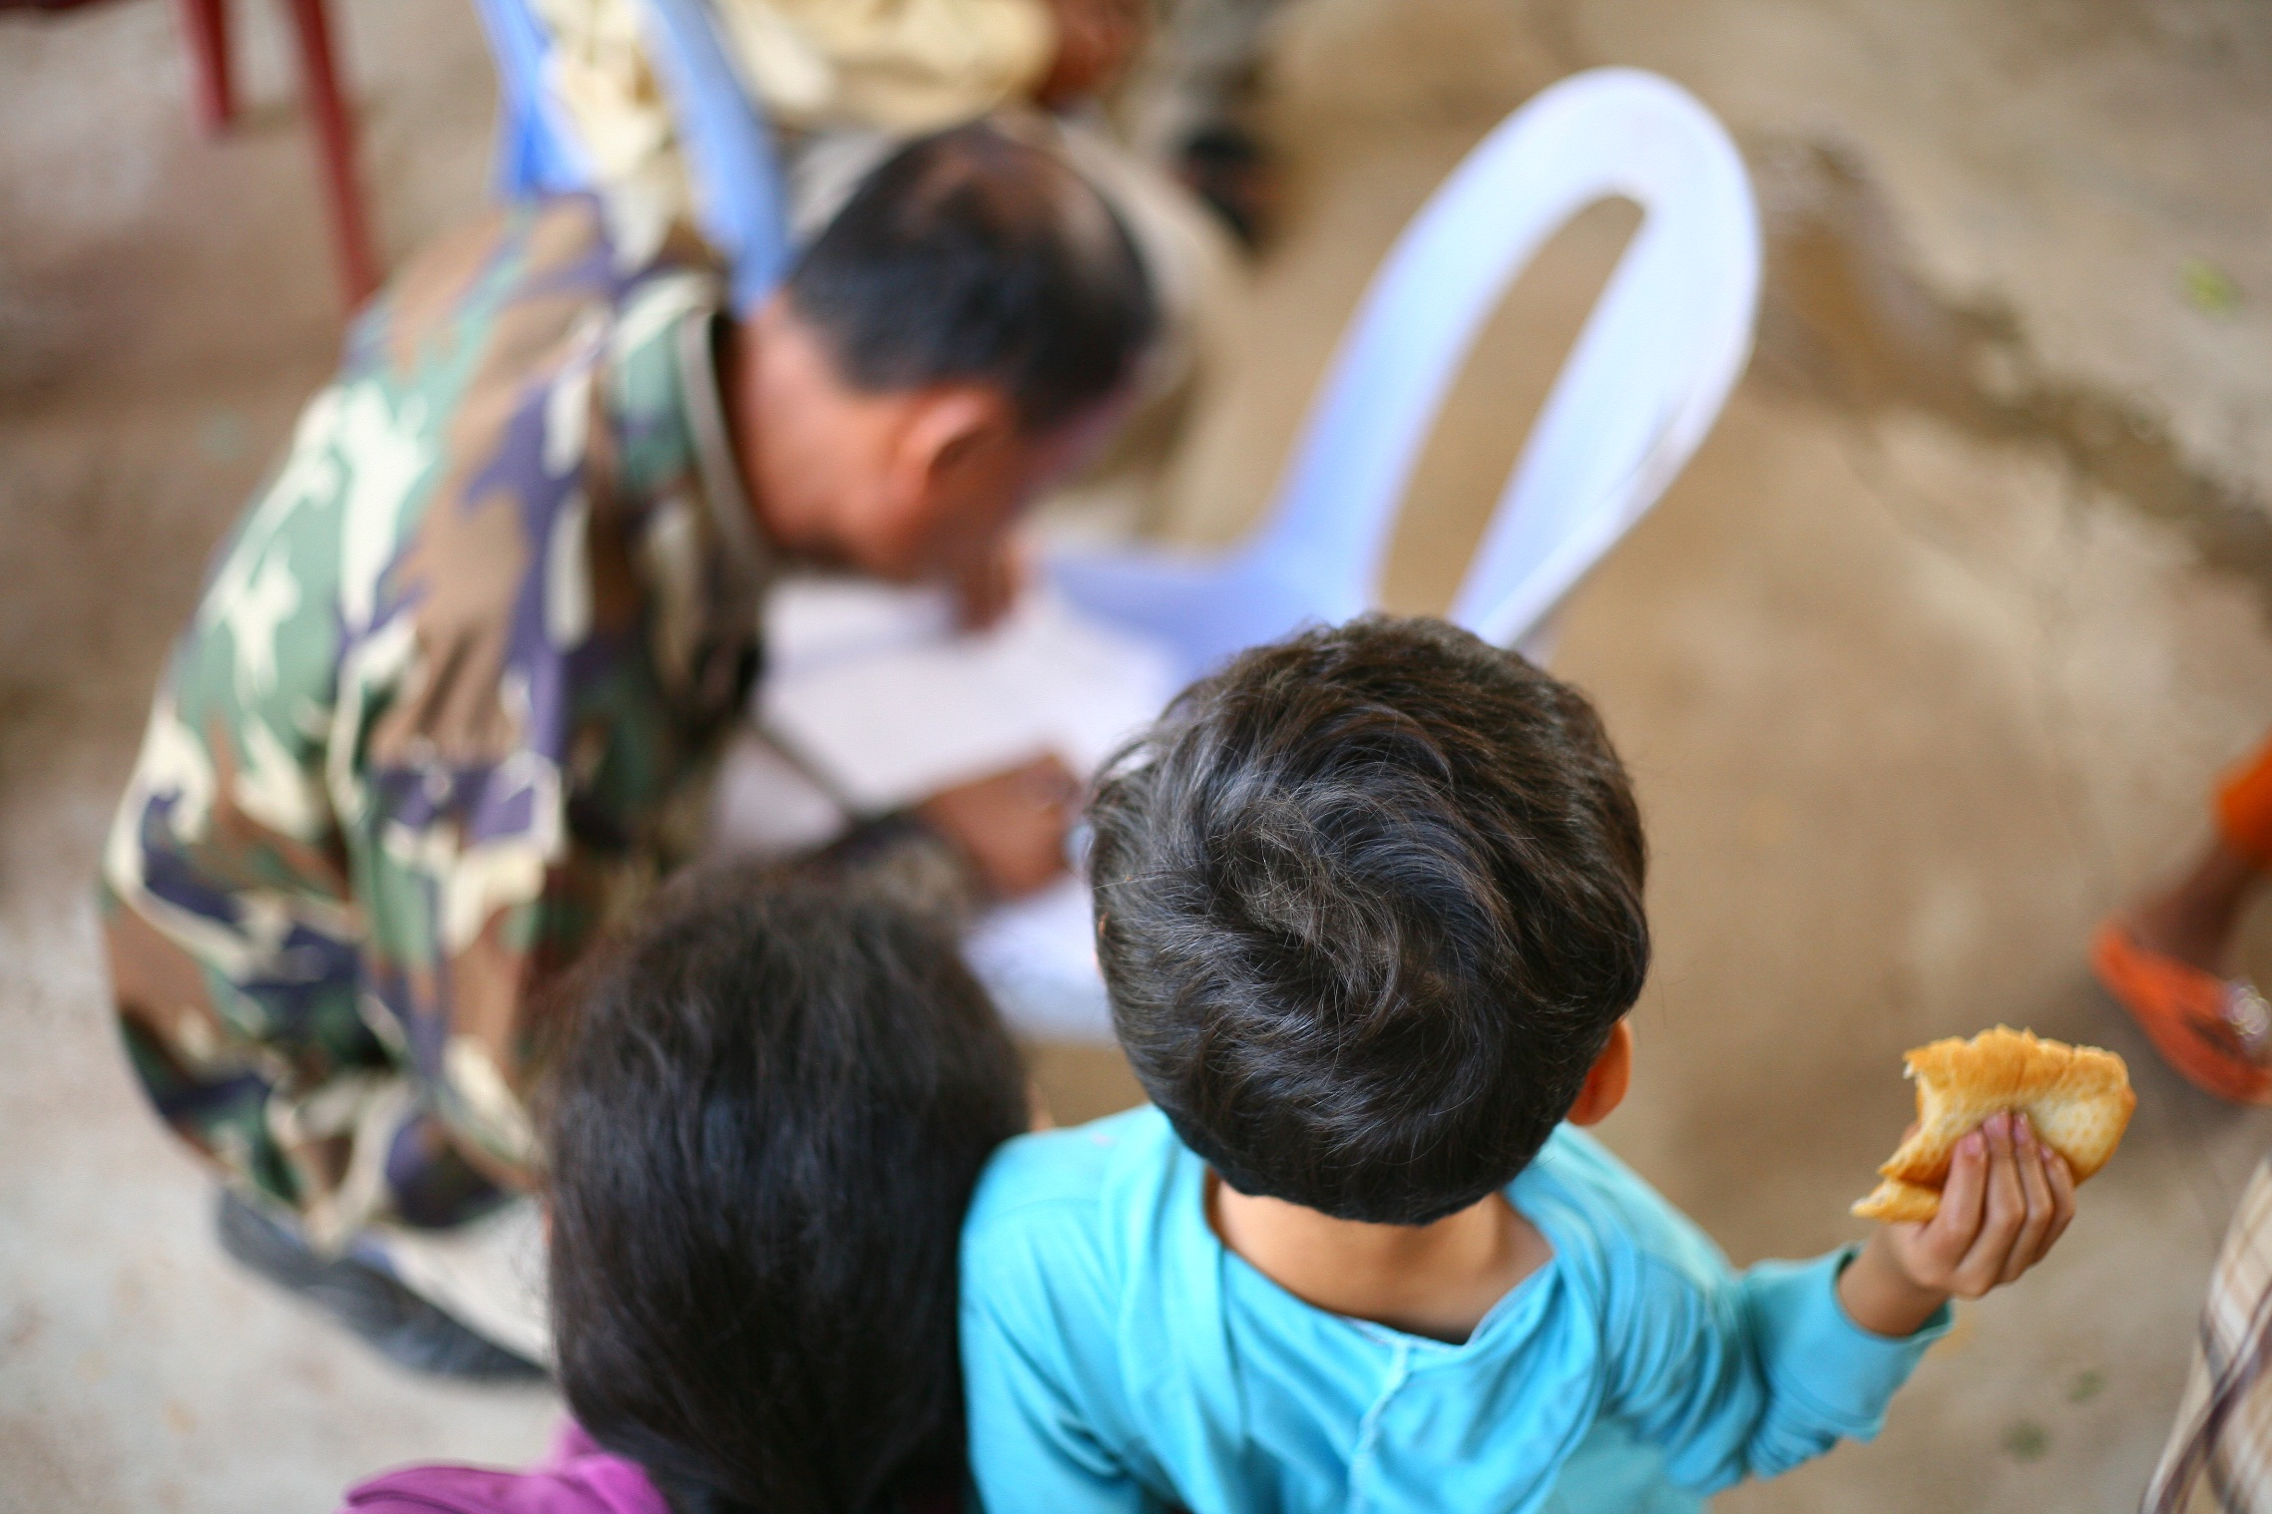
The local Cambodian police ask parents to sign and commit not to bring their children along with them to beg in Vietnam. For some parents and children, it is not the first repatriation.

Slide 14
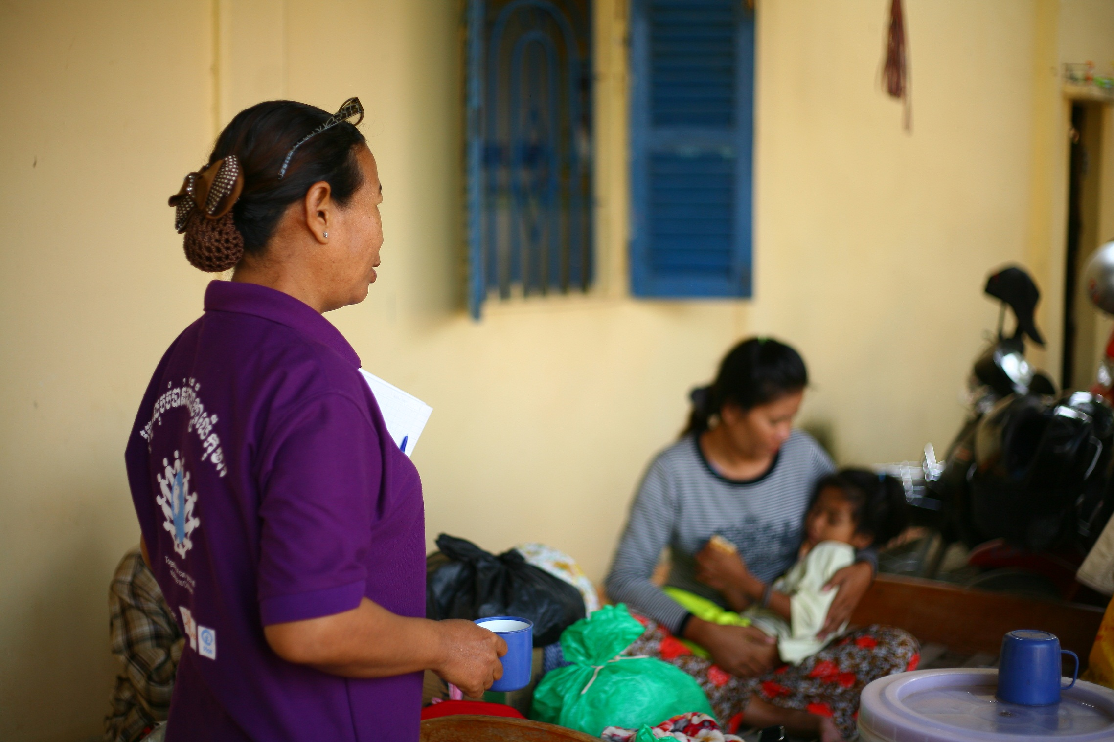
CTIP‘s partner CCPCR’s social workers provide medical support to returnees when needed.

Slide 15
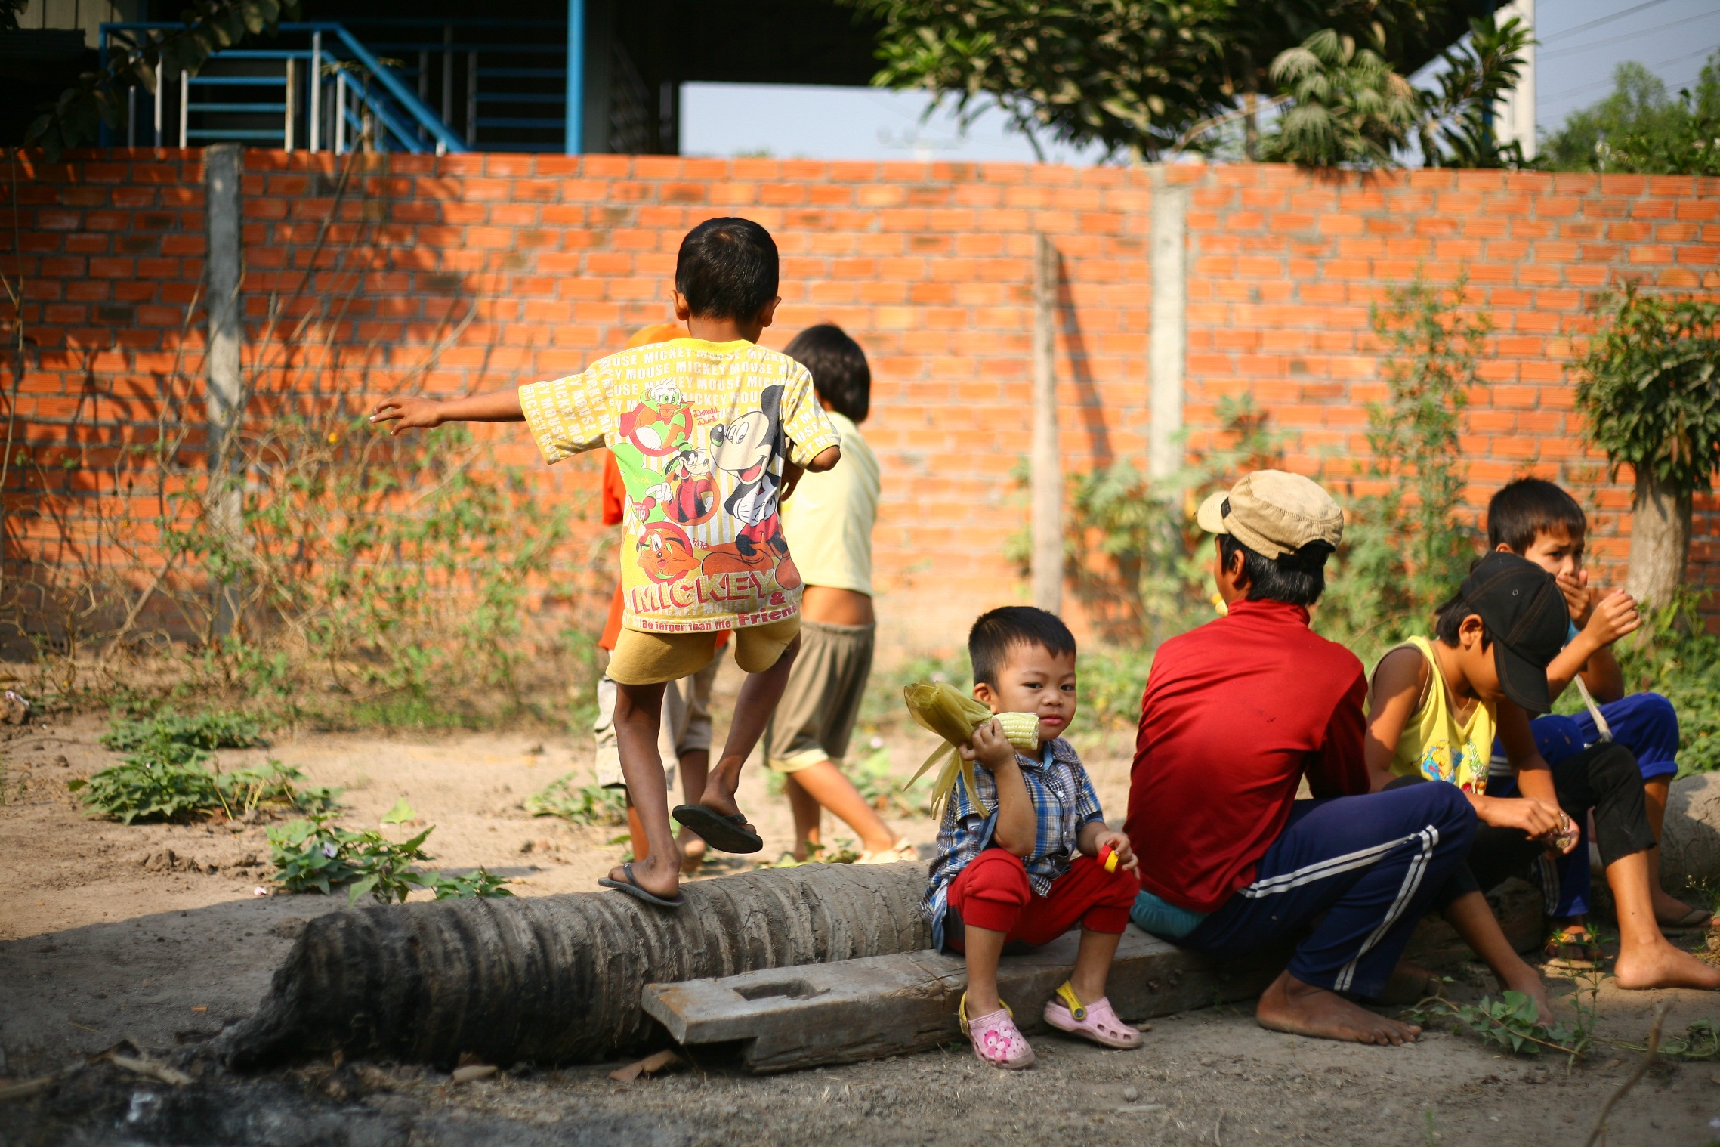
After a certain moment, children spontaneously start playing at the center.

Slide 16
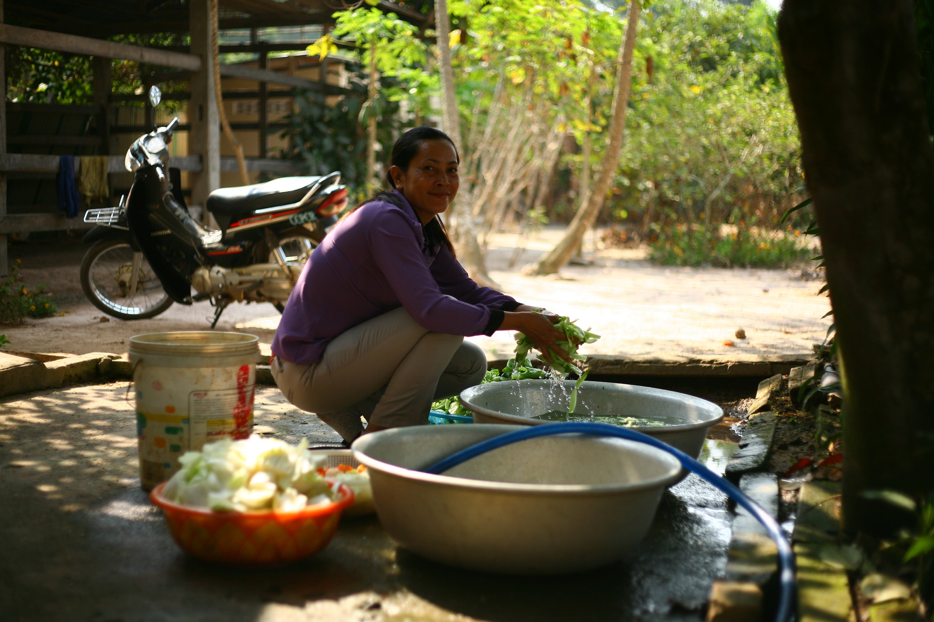
Now it is time to cool down from the excitement and have some food. CTIP’s partner CCPCR provides basic services to returnees: food, accommodation, transportation, counseling and medical check-up and treatment.

Slide 17
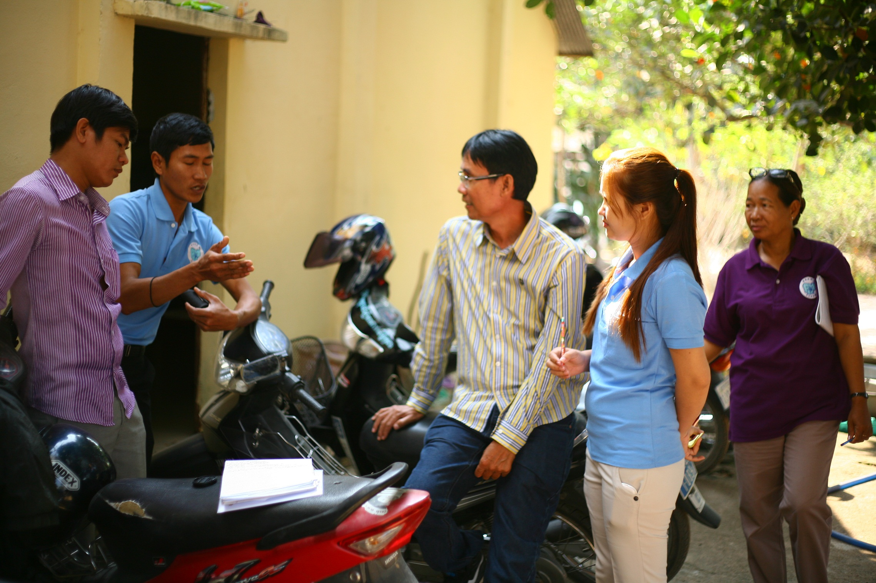
At the end of the morning, CTIP’s partner CCPCR quickly meets to share their feedback about the quick victim identification screening. As from the afternoon, they will individually meet every returnee and interview them in depth to confirm the victim identification and know their needs. Interviewing all returnees can take up to a week, depending on figures.

Slide 18
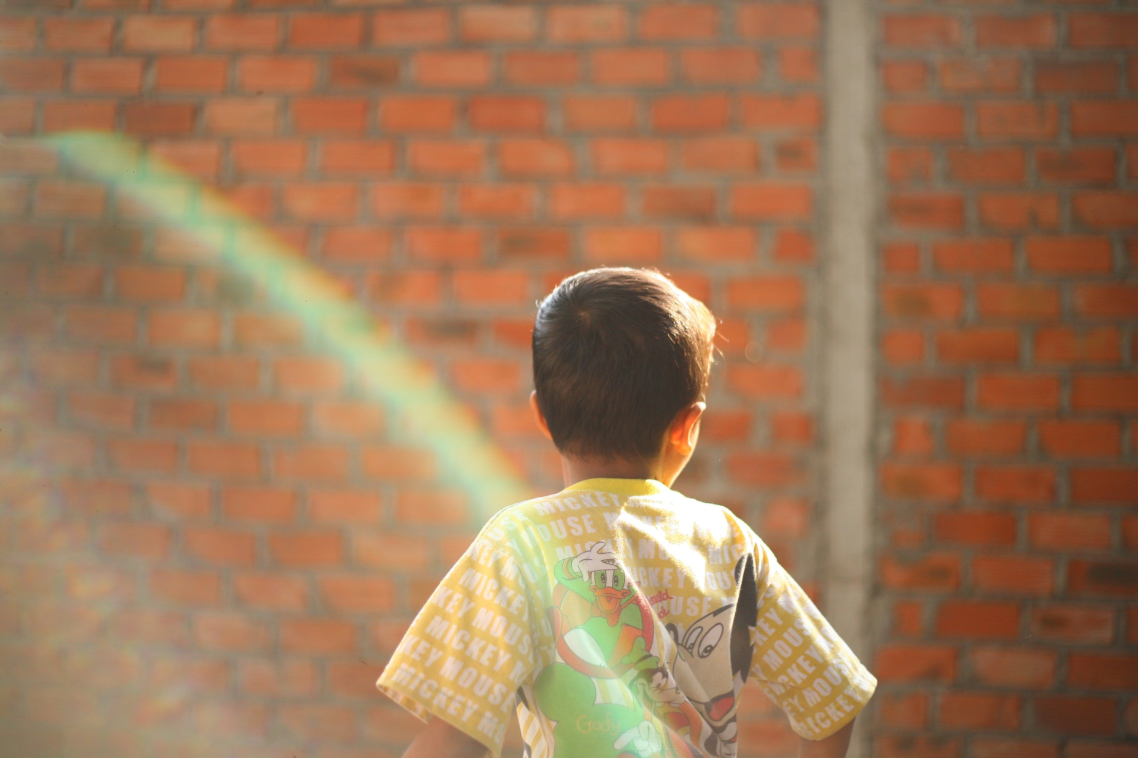
If they identify them as victims of human trafficking, CTIP will establish a plan and provide them education or develop their skills. If required, CTIP will refer them to other local NGOs for further support.

Slide 19
Every month, CTIP repatriates Cambodian migrants from Vietnam and Thailand. During those repatriations, CTIP identifies victims of trafficking that they assist in their reintegration into their community when possible. Since the beginning of the project in 2011, CTIP helped repatriate 514 survivors of trafficking.
“We provide counselling to former child beggars to help them recover from the trauma of their human trafficking experience”, says Vuthy, social worker of CTIP’s partner CCPCR.
“Most children just want to go to school. But their parents are too poor to buy them books or a bicycle to go to school. Some families have also domestic violence issues, health problems or debts”, says Sothida, social worker of CTIP’s partner CCPCR.
“In Vietnam, those children experience difficulties to find food, clothes and accommodation. Most of them sleep on the streets or in parks. They remain in this situation between a couple of days to a couple of months before being arrested”, says Somnang, social worker of CTIP’s partner CCPCR.

Slide 20
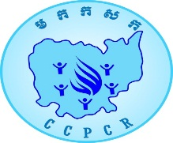
Because an ounce of prevention is certainly worth a pound of cure, CTIP conducts prevention activities and increases the livelihood options of poor communities vulnerable to human trafficking throughout the country:
Trains communities (villagers, specifically youth, and local authorities including commune police, village chiefs and teachers) to bring about behavioral changes in all targeted provinces;
Created 3 Self-Help Groups and saving groups in Svay Rieng Province (104 members, 67 % of women). After one year of CTIP’s work, 100% of SHG members have a job and 60% have repaid their debts. Migration and school dropouts have considerably decreased and in the two target communes, the number of children sent to Vietnam to beg has decreased by 74%;
Created a rice bank in Svay Rieng Province. The bank plays an important role in the community by providing rice at low cost to its 60 members during periods of food shortage and by controlling the price of rice to avoid falls in price;
Directly assists survivors of human trafficking (job placement, vocational and life skill training, education, legal, psychological and medical support, family assessment, development of business plans and award of grants, etc). So far, CTIP has assisted 955 survivors of human trafficking.

