Slide 1
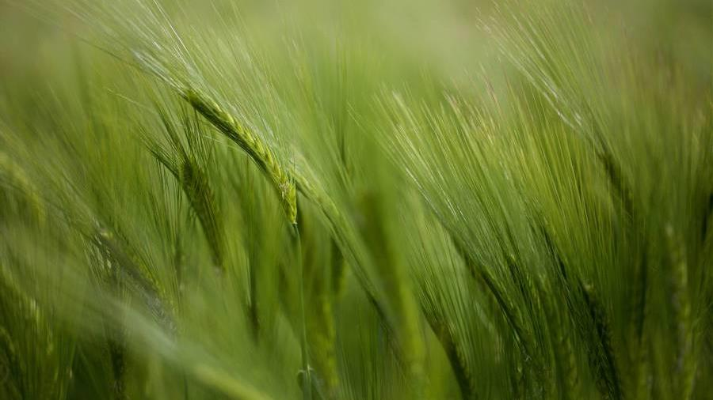
Introduction to USDA Organic Certification
​

Slide 2
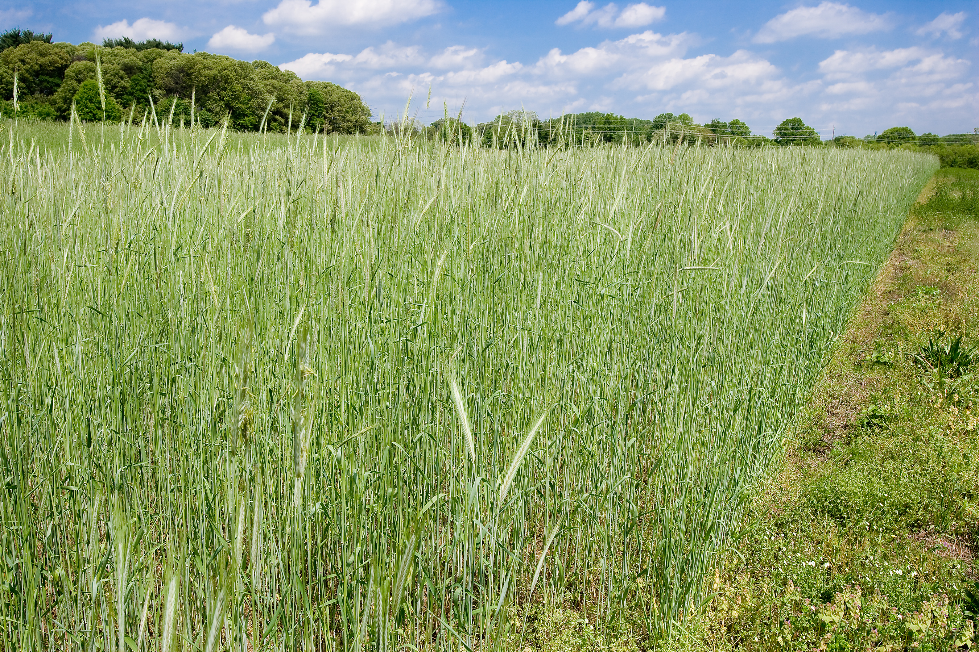
Information Sources
www.usda.gov/topics/organic
www.ams.usda.gov/services/organic-certification
Local USDA offices – FSA or NRCS

Slide 3
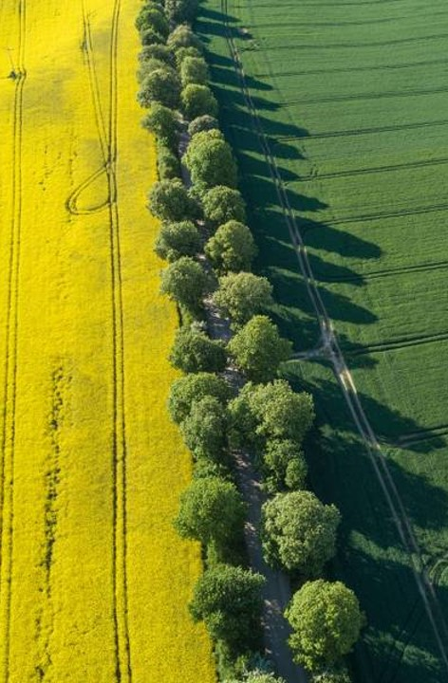
Topics
Basics
How to Become Certified
Transition period
Record keeping
CERTIFIERS & COSTS

Slide 4
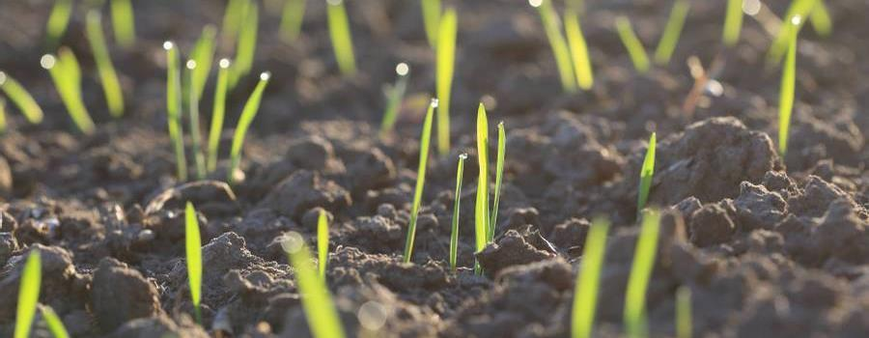
Basics
What is “Organic”?
Organic Standards
A labelling term indicating that food or products were produced by approved methods.
Farming practices that Integrate biological, cultural, and mechanical practices to foster cycling of resources, promote ecological balance, and conserve biodiversity.
Excludes synthetic fertilizers and pesticides, irradiation, GMOs.
Differs from other industry labels: free-range, cage-free, natural, grass-fed, pasture raised, humane.
USDA Ag Marketing Service oversees all ag products sold, labeled, or represented as organic in the United States.
USDA National Organic Program develops standards, enforces regulations, authorized by Organic Foods Production Act of 1990.
Organic Standards: requirements verified by the certifying agent.
Certification categories (scopes): crops, wild crops, livestock, and handling/processing.

Slide 5
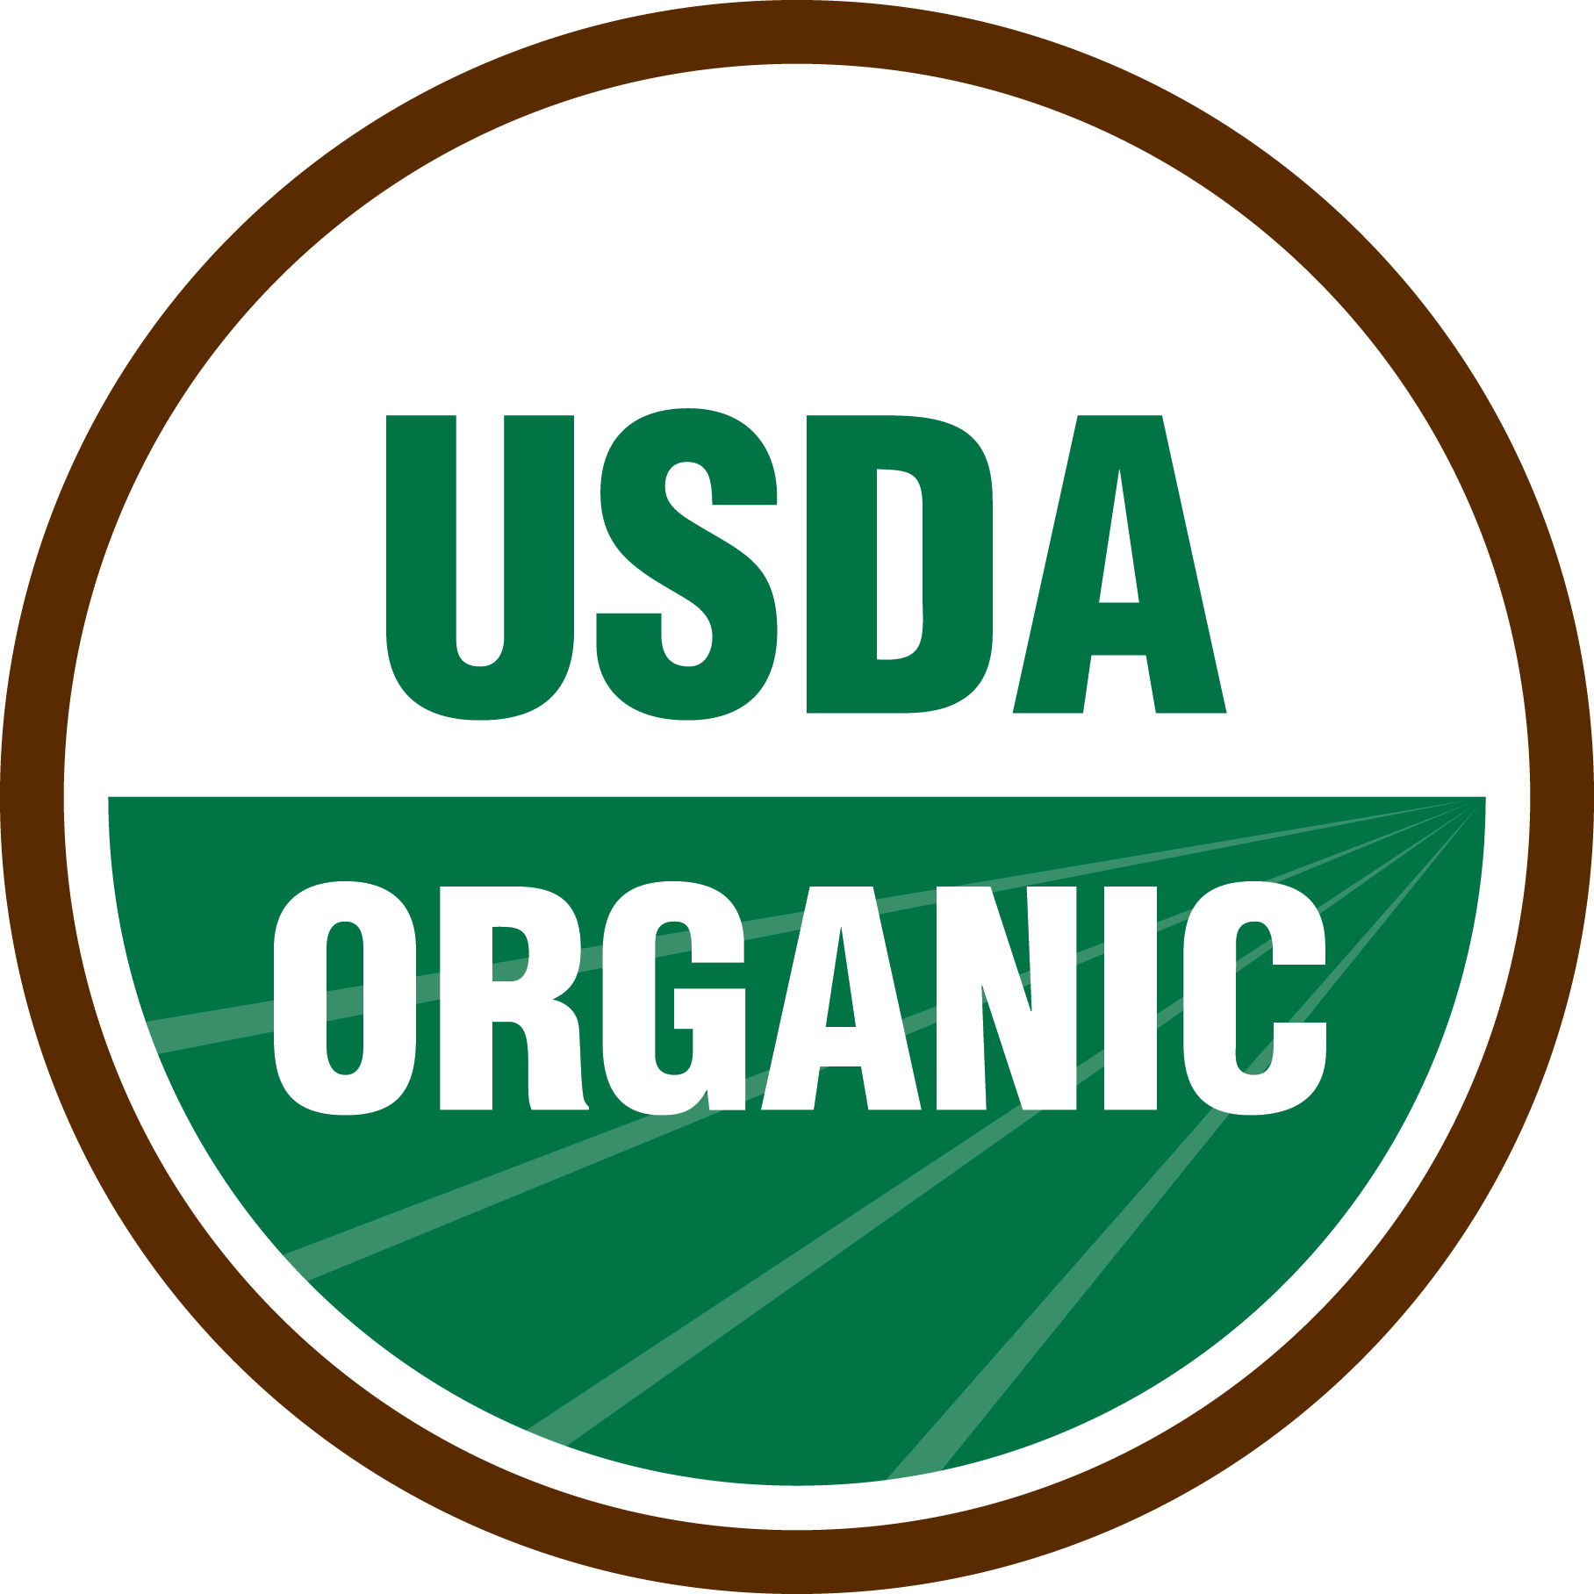
USDA Organic Label

Slide 6
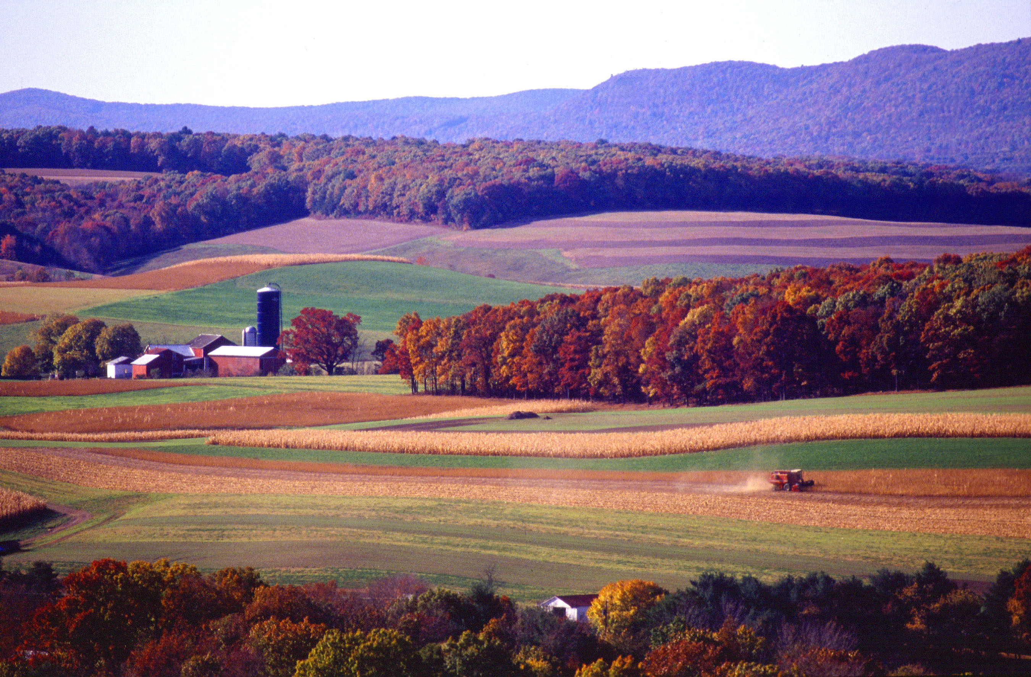
Basics continued
Organic certification may require
Environmental Stewardship:
Must use practices that use on-farm resources, promote ecological balance, and conserve biodiversity.
Fertility and Nutrient Management:
Develop soil health by relying on natural materials, like cover crops, manure, and compost.
Pest Management:
Must use preventative measures and physical controls before using approved pesticides.
Synthetic Substances:
Must limit use to approved items, excluding sewage sludge, irradiation, or GMOs.

Slide 7
Basics continued
Common organic farming practices
Building fertility and soil health with
Slow-release sources of crop nutrients such as manure or compost.
Crop rotations to manage nutrients and control erosion.
Controlling pests through
Beneficial habitats to harbor predators of crop pests.
Diverse crop rotations to disrupt pest and disease cycles.
Cover crop plantings to suppress weeds.
Protecting natural resources by
Planting field borders with flowering plants to provide pollinator habitat.
Establishing buffer strips or tree rows to filter runoff water.

Slide 8
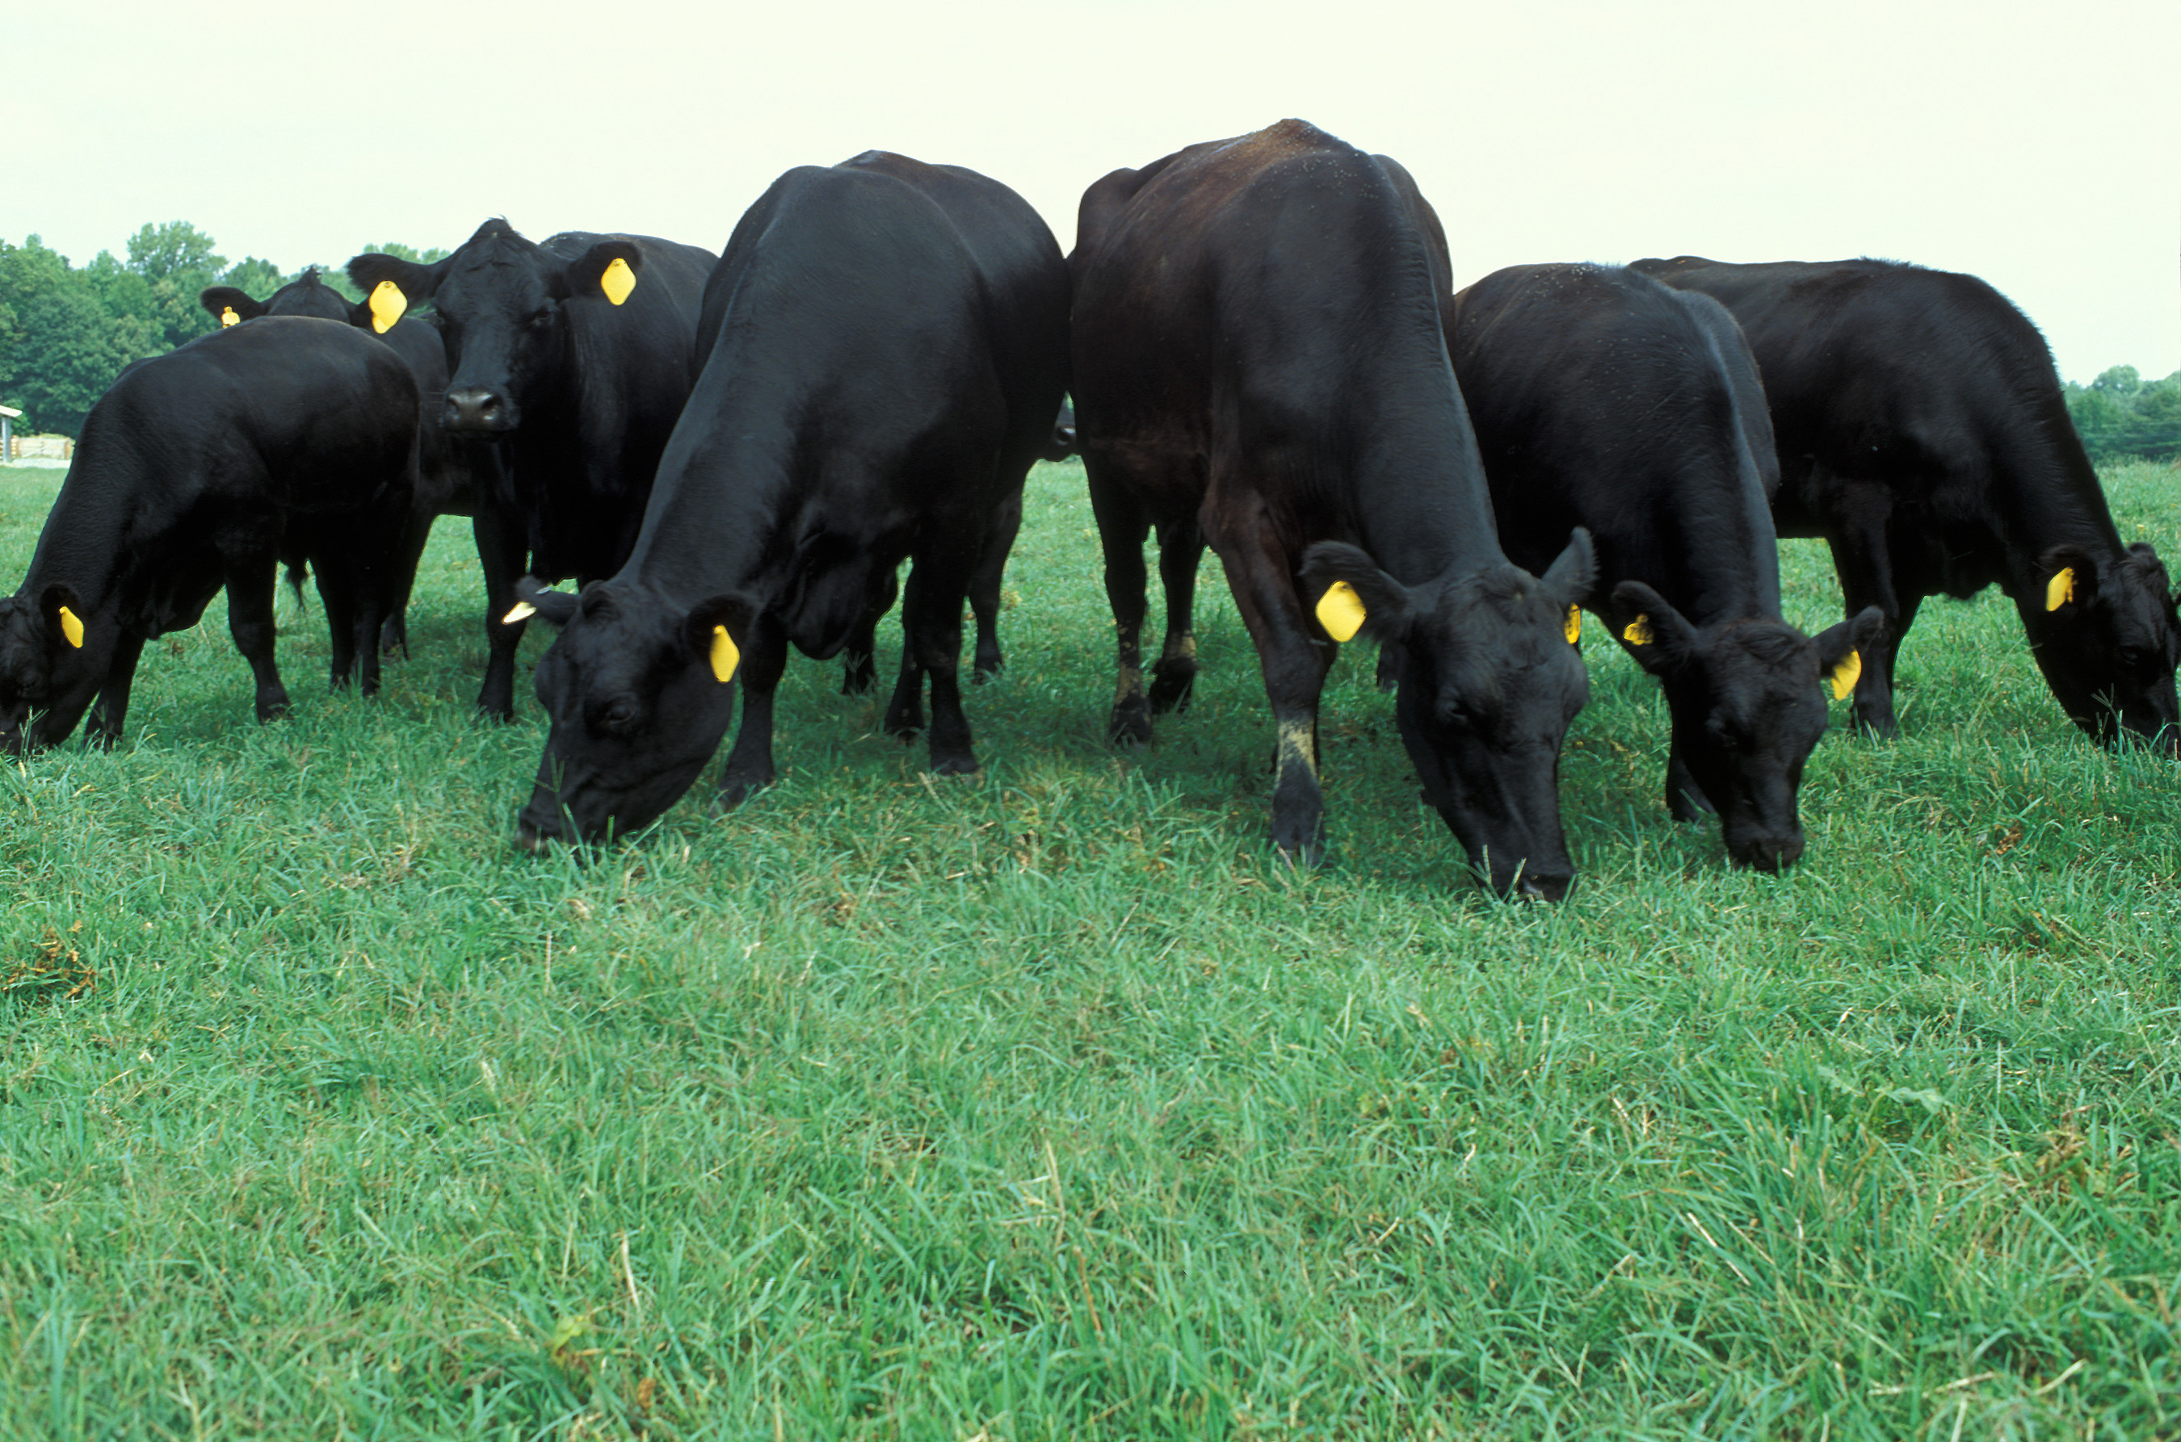
Basics continued
Common organic livestock practices
Organic Feed
Organic livestock must consume only certified organic feed.
Ruminants must have access to pasture during the grazing season.
Living Conditions
Animals must have access to the outdoors, shade, shelter, space for exercise, clean water, and more.
Animal Health
Organic healthcare emphasizes preventative practices.
Organic animals may not receive antibiotics or growth hormones.

Slide 9
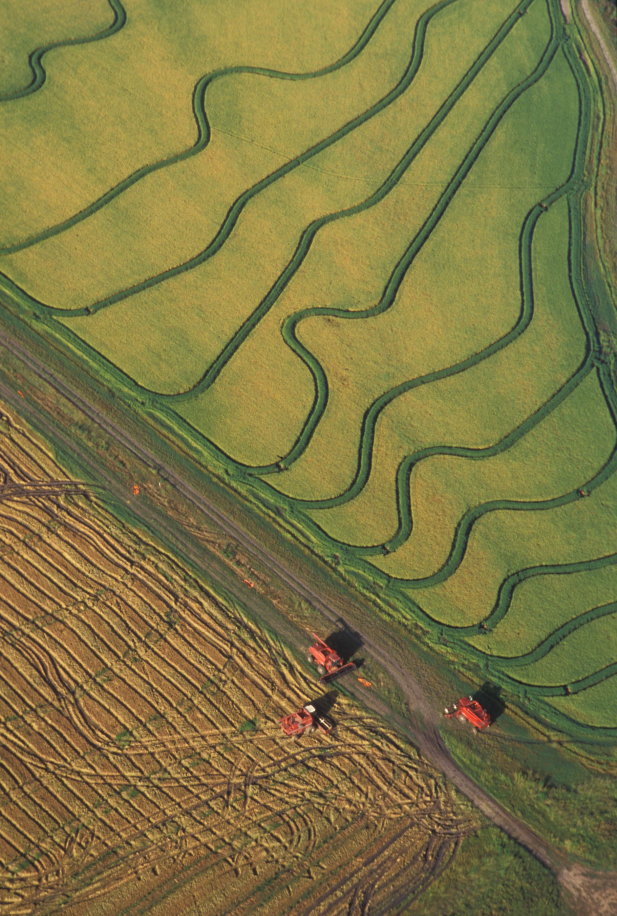
How to become certified
steps​
Farm adopts organic practices, selects an accredited certifying agent, and submits an application and fees to agent. ​
Certifying agent reviews application and verifies compliant practices.
An inspector conducts on-site inspection.
Certifying agent reviews the application and inspector’s report to determine if compliant with USDA organic regulations.
Certifying agent issues certificate.

Slide 10
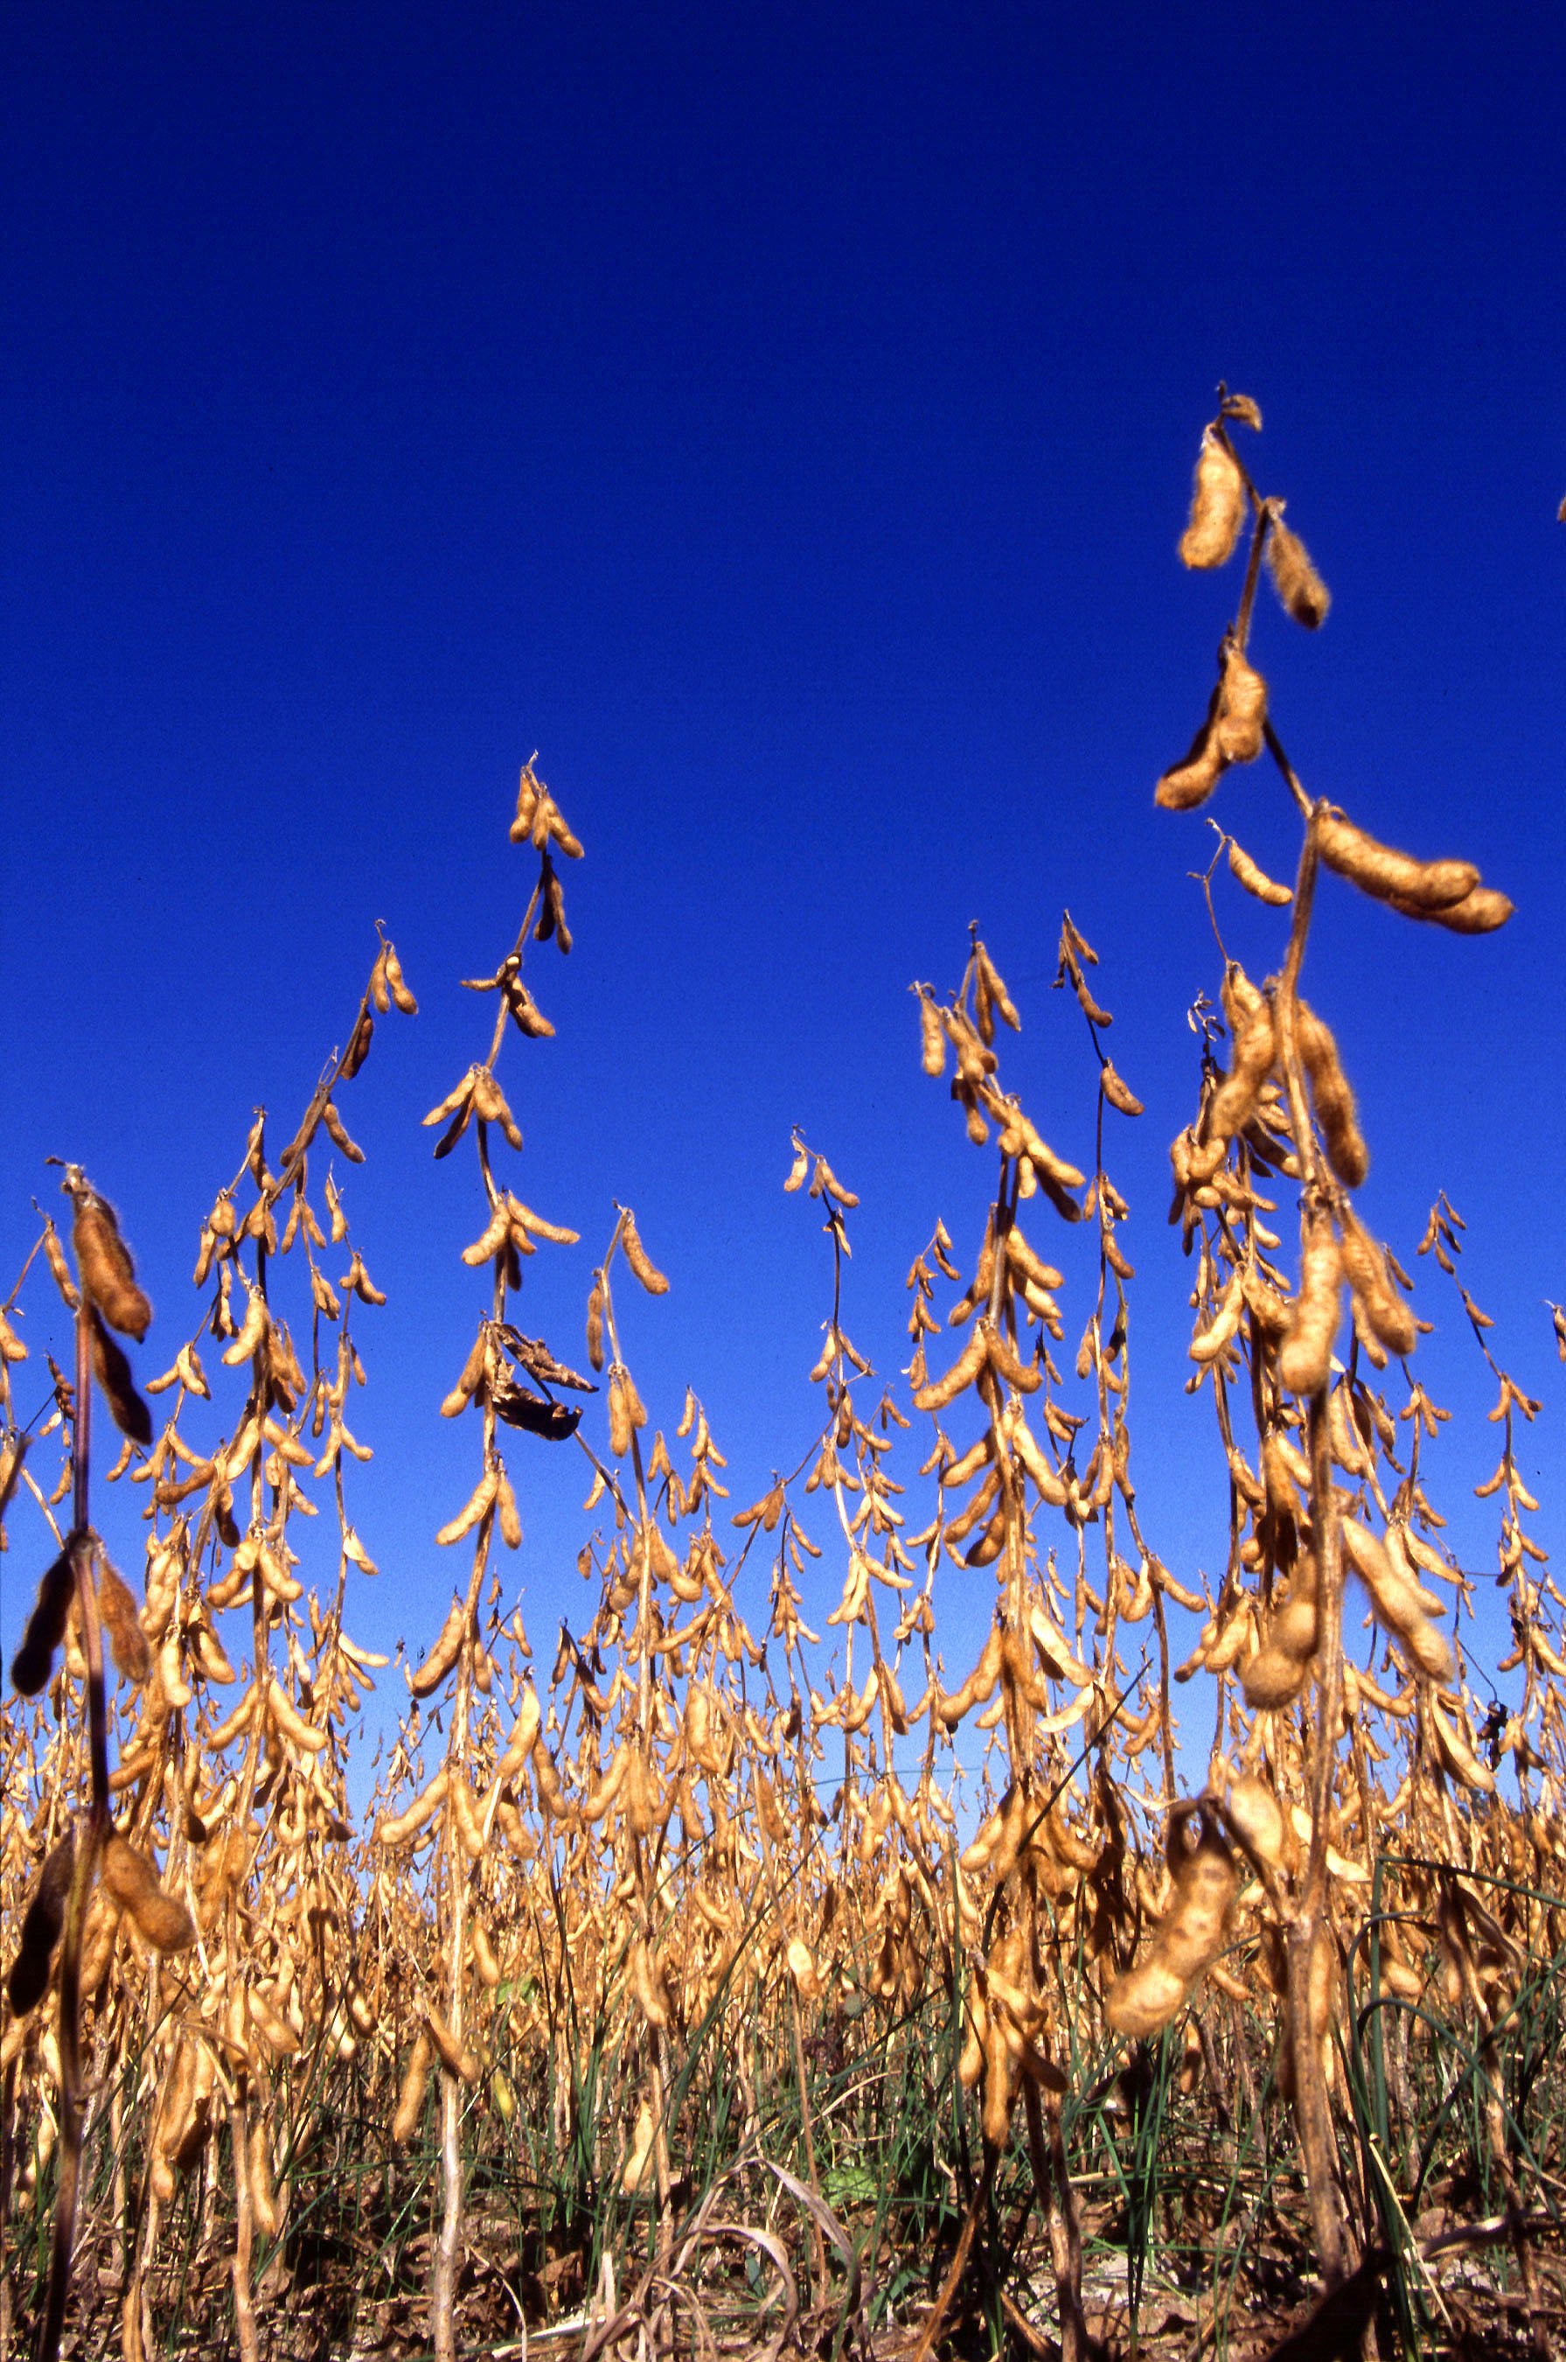
How to become certified
Eligibility​
Land must have been free of prohibited substances for 3 years.
Applicants should document the last date on which prohibited substances were applied to the land.
Both conventional and organic production may occur on the same farm.
Buffer zones may be required if prohibited substances are used on adjacent parcels or neighboring lands.
No size requirements – both small and large farms may be certified organic.
Exemption for gross organic sales of less than $5,000/year; restrictions apply.

Slide 11
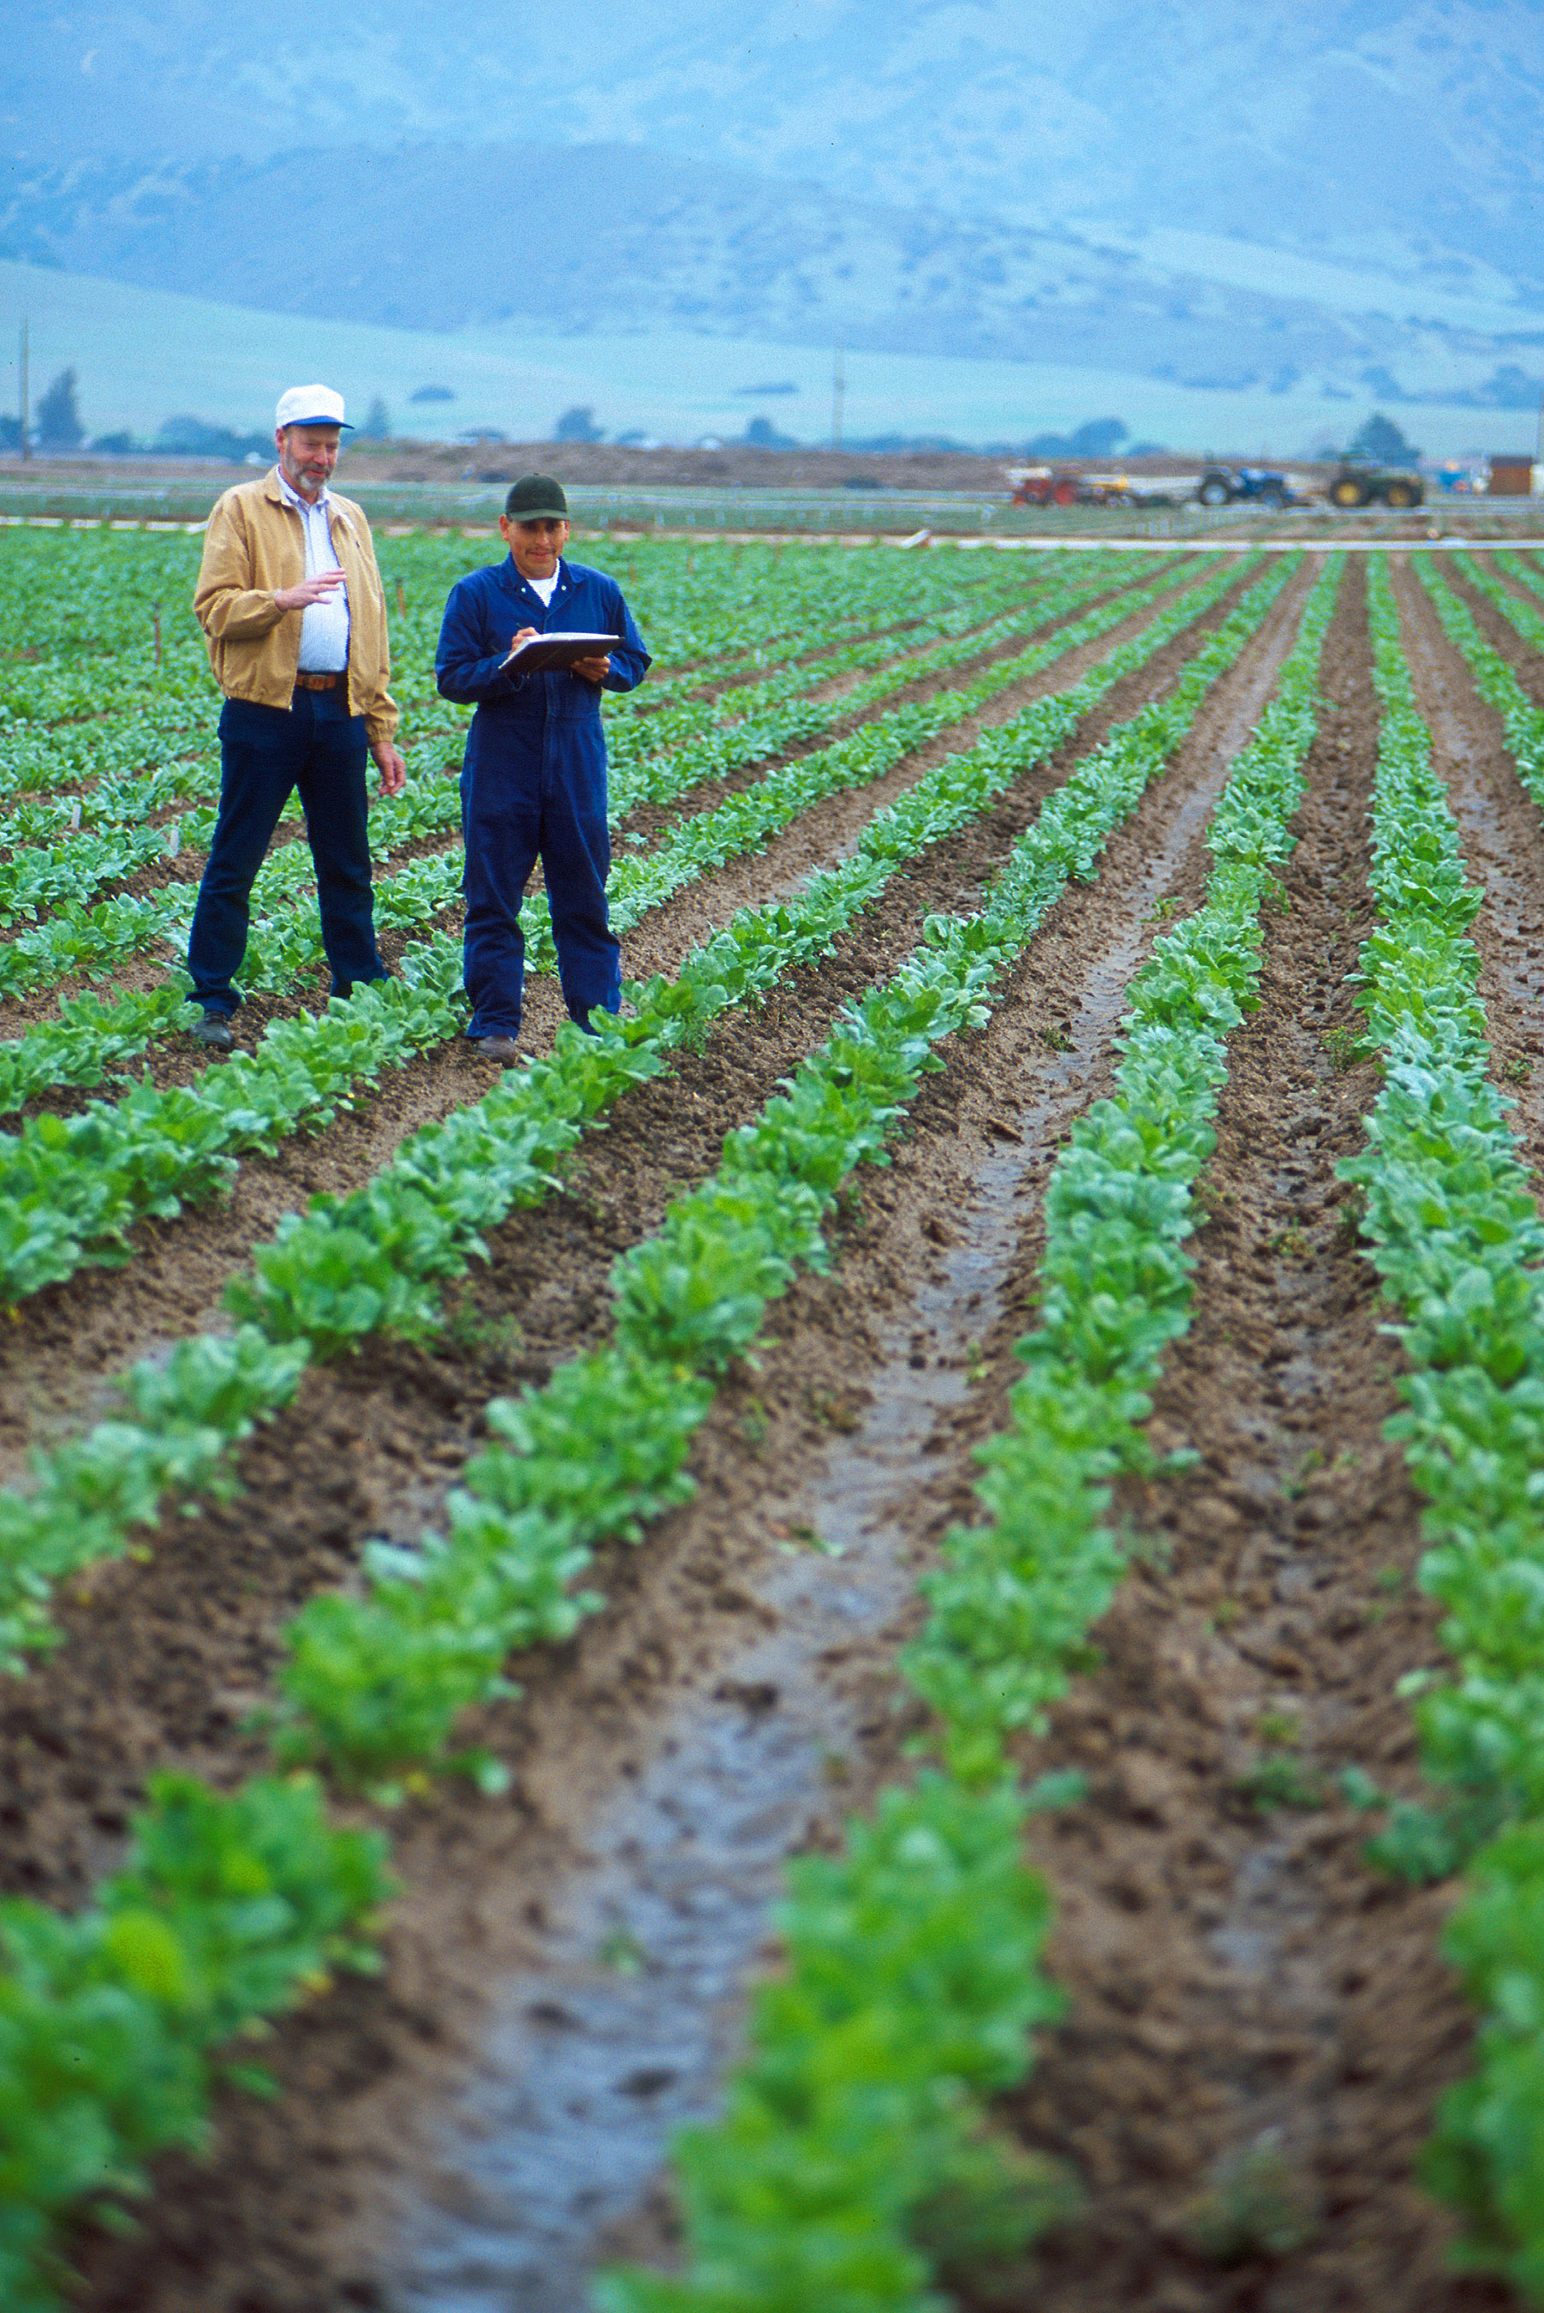
How to become certified
Getting started In Organics​
First step is to end use of all prohibited substances.
Many farmers begin organic practices gradually.
Transition small parcels of the farm to organic, then add other parcels each year.
Leasing or buying land that was not in production (fallow land) to allow for immediate organic certification.

Slide 12
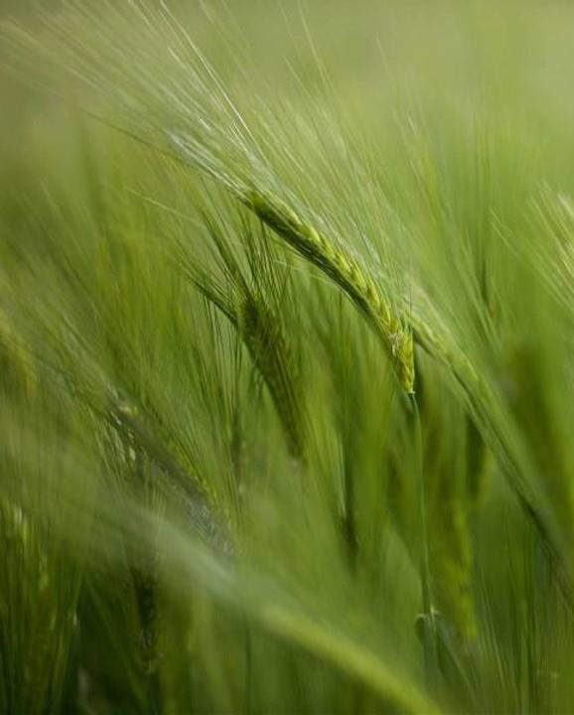
Transition Period
​
Three years
Cannot use prohibited substances. Crop harvest must occur after 36 months since last use.
Fallow land
Some land may be certified more quickly if you can show that 3 years has passed without prohibited substances used.
Allowed / Prohibited
National List of Allowed and Prohibited Substances.
Natural substances allowed, and synthetic substances prohibited, unless stated otherwise.

Slide 13
Record keeping
Activity logs
Organic System Plan
Current year field plan
Health records for livestock
Describes how your operation meets the organic standards.
Materials list, Map of land, Field history, Biodiversity plan.
Annual updates.
Annually after first OSP.
Records for split operations.
To document field work activities, handling.
To document feeds, treatments, grazing days, etc.

Slide 14

Certifiers
Certifying Agents
USDA does not certify operations directly, but accredits 3rd party certifiers to handle applications.
Certifiers verify that farms or businesses meet USDA organic standards and grant annual certificates.
About 80 certifiers worldwide; 50 in USA.
Farms can work with any certifying agent.
www.ams.usda.gov/nopacas
Website tool lists agents in each state.

Slide 15
costs
Certifying Agent Fees
Fees are set by each certifying agent.
Fees can vary widely between agents.
Most have a fee schedule posted on their website.
Total cost to certify a farm or business each year is related to complexity of operation, number of acres, or number of scopes to be certified.
​

Slide 16
Cost share programs
USDA Cost-Share Programs
Organic Certification Cost Share Program OCCSP
- for certified operations that have paid fees
- reimburses 50% of annual cost up to $500 per scope
Organic and Transitional Education and Certification Program OTECP
- Certified: 25% of eligible certification fees.
- Certified: 75%, up to $200, educational registration.
- Certified: 75%, up to $100, required soil testing.
- Transition: 75% of eligible costs up to $750.
- Transition: 75%, up to $200, educational registration.
- Transition: 75%, up to $100, required soil testing.
Contact your local USDA Farm Service Agency office for more details on eligibility.
Agricenter International. ​

Slide 17
USDA websites
National Organic Program www.ams.usda.gov/about-ams/programs-offices/national-organic-program
USDA Organic www.usda.gov/topics/organic
USDA Organic Standards www.ams.usda.gov/grades-standarnds/organic-standards
Organic Certification and Accreditation www.ams.usda.gov/services/organic-certification

